Slide 1


Slide 2
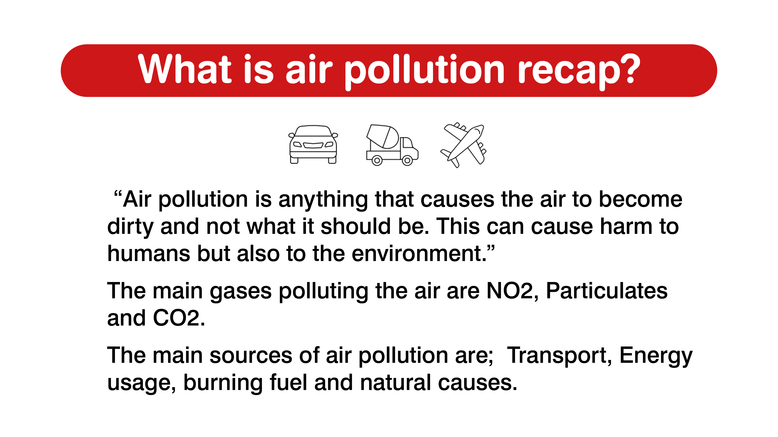

Slide 3
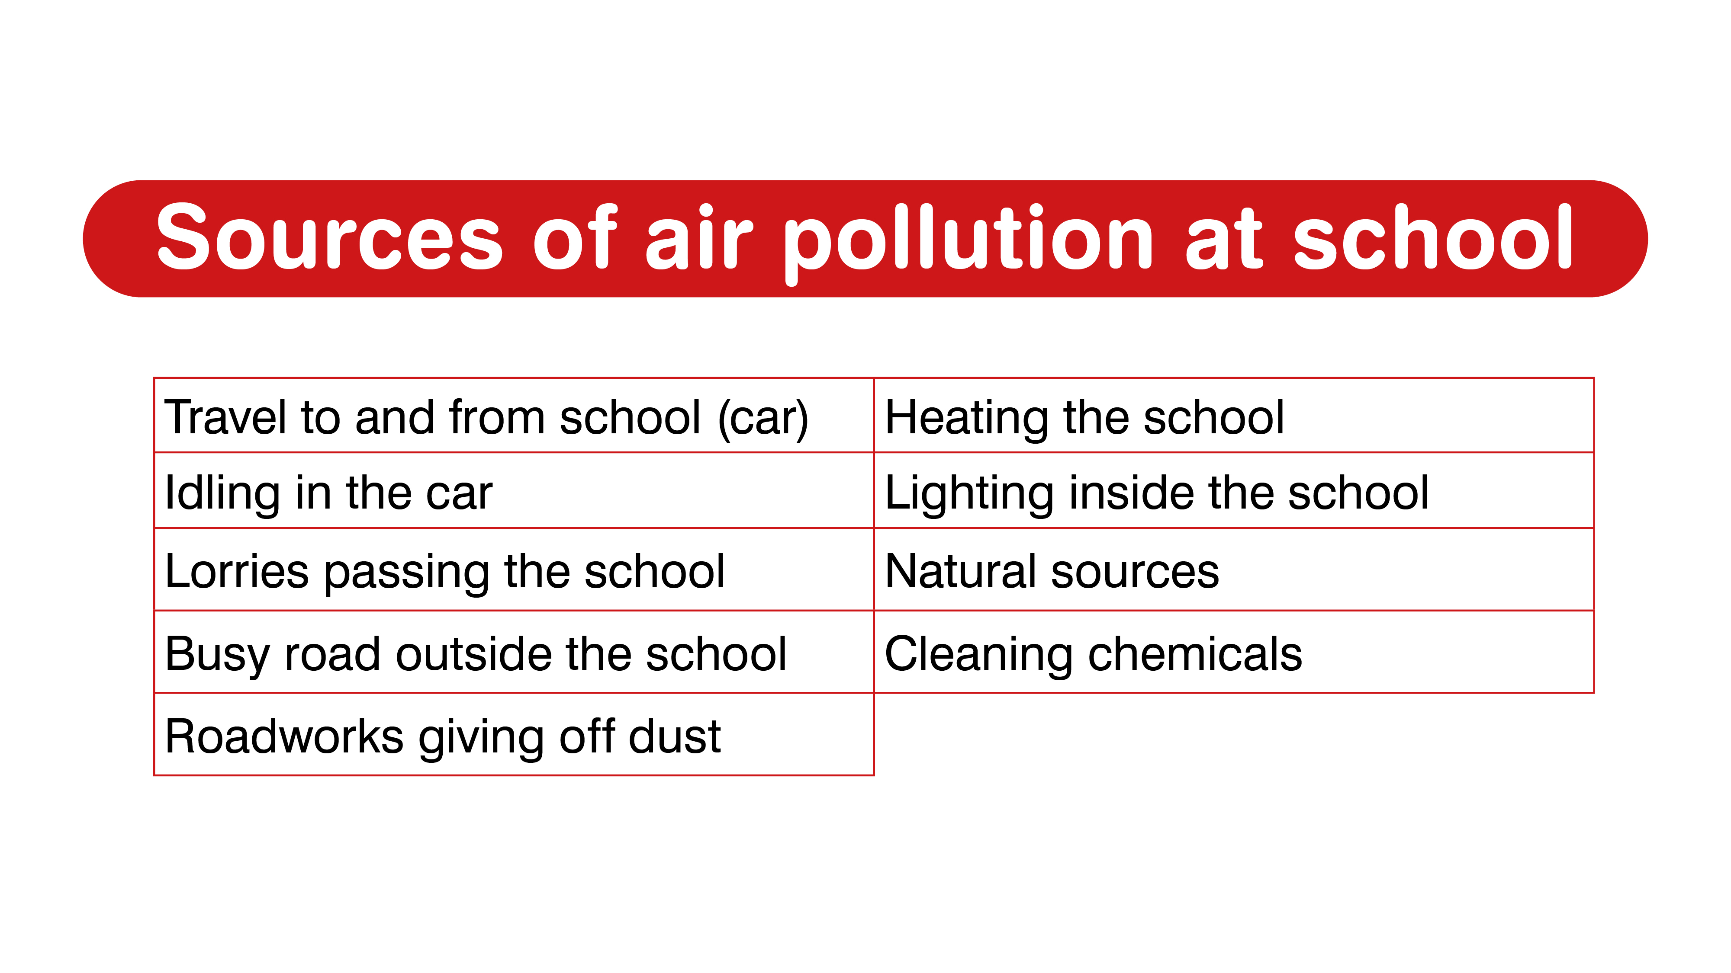
Notes:
Activity: Get the students to work as a group to think of all the different sources of air pollution at and around the school. Come together and get the students to share their answers and then show the different sources.

Slide 4
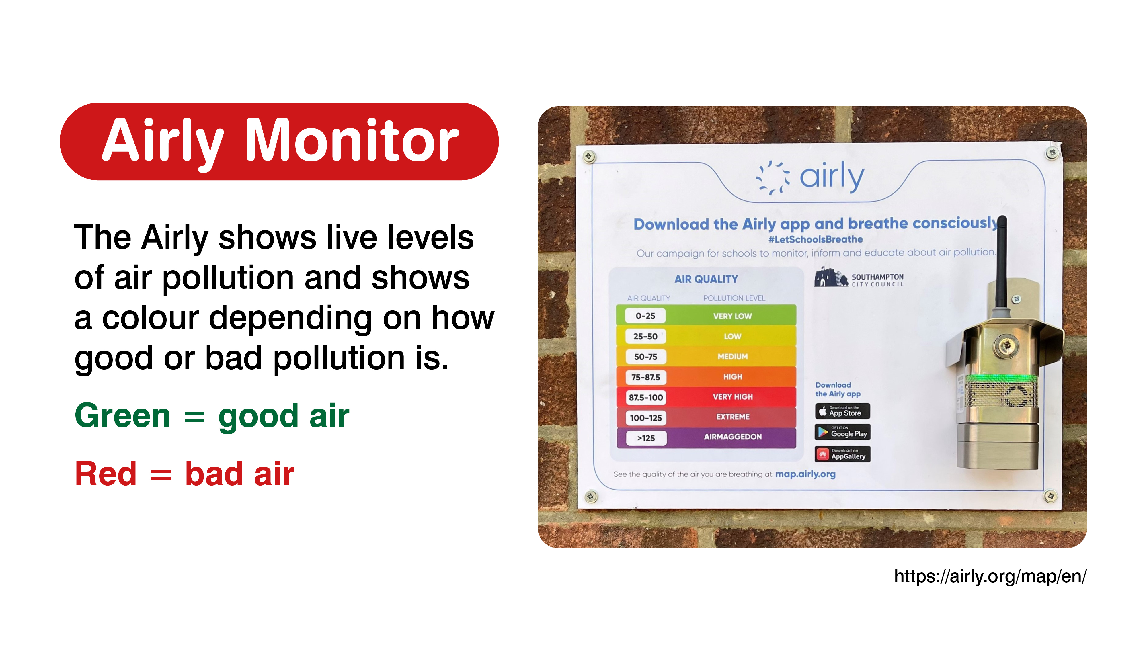
Notes:
PAGE ONLY FOR THESE SCHOOLS (St Johns, Banister, St Annes, Redbridge P, Redbridge C, St Mary’s, Sholing Junior, Bassett green, Freemantle, Maytree infants) – delete if you have a diffusion tube and don’t have this sensor
Airly air quality monitor:
Introduce the Airly as an air quality sensor.
It shows live levels of air pollution and shows a colour depending on how good or bad pollution is.
Show the students where the Airly has been located in the school (either in person or by picture and explanation).
Look at the Airly map together on a screen and look through the NO2 pollution data for the past 24 hours of data. Access to the Airly map is here: https://airly.org/map/en/.
Explain that:
This machine measures the pollution mostly made by road transport.
Ask the students where they think the best place to put the sensor is if they want to measure an area students spend most of their time in? How about an area they think will be most polluted?
The ideal places would be the school playground or the main entrance and near the main road by the school
Get them to see how the bar chart at the bottom shows peaks and troughs, usually around school run times

Slide 5
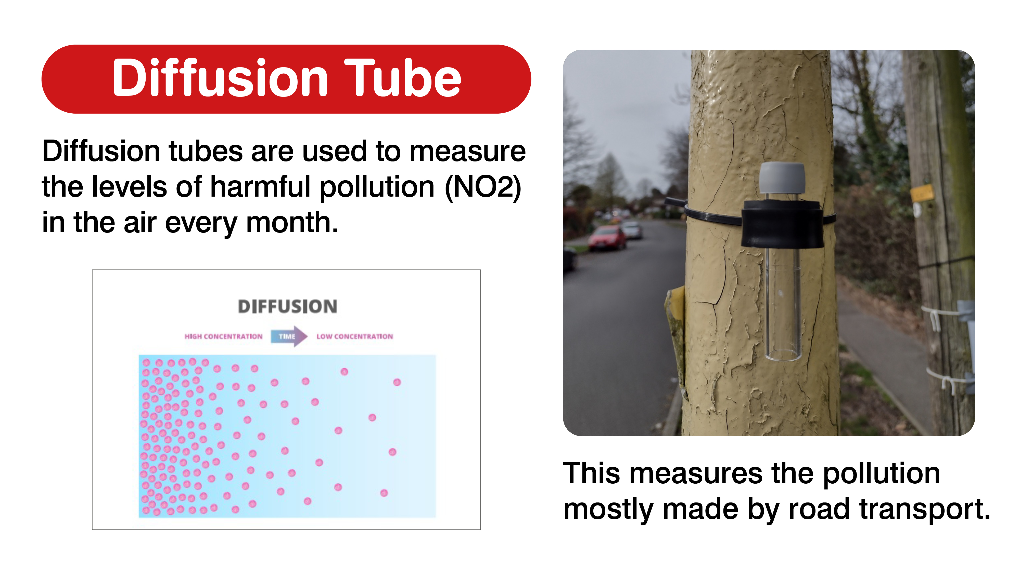
Notes:
PAGE ONLY FOR SCHOOLS with a diffusion tube
Diffusion tubes:
Introduce the diffusion tubes and explain to the students that they’ll be used to measure the levels of nitrogen dioxide around their school.
Explain that Diffusion tubes are used to measure the levels of harmful Nitrogen Dioxide in the air, by use of a sampling tube and a filter. The more nitrogen dioxide in the air the more polluted. This measures the pollution mostly made by road transport.
Diffusion tubes are small plastic tubes with a cap at each end one of which is coloured. Under the coloured cap is a steel mesh disc which is coated with triethanolamine (TEA) a chemical that absorbs nitrogen dioxide.
When gases pass over this mesh the chemical changes. This chemical change tells us how much nitrogen dioxide was in the air during the monitoring period.
The bottom white cap is removed so that the air can get into the tube in a process known as molecular diffusion

Slide 6
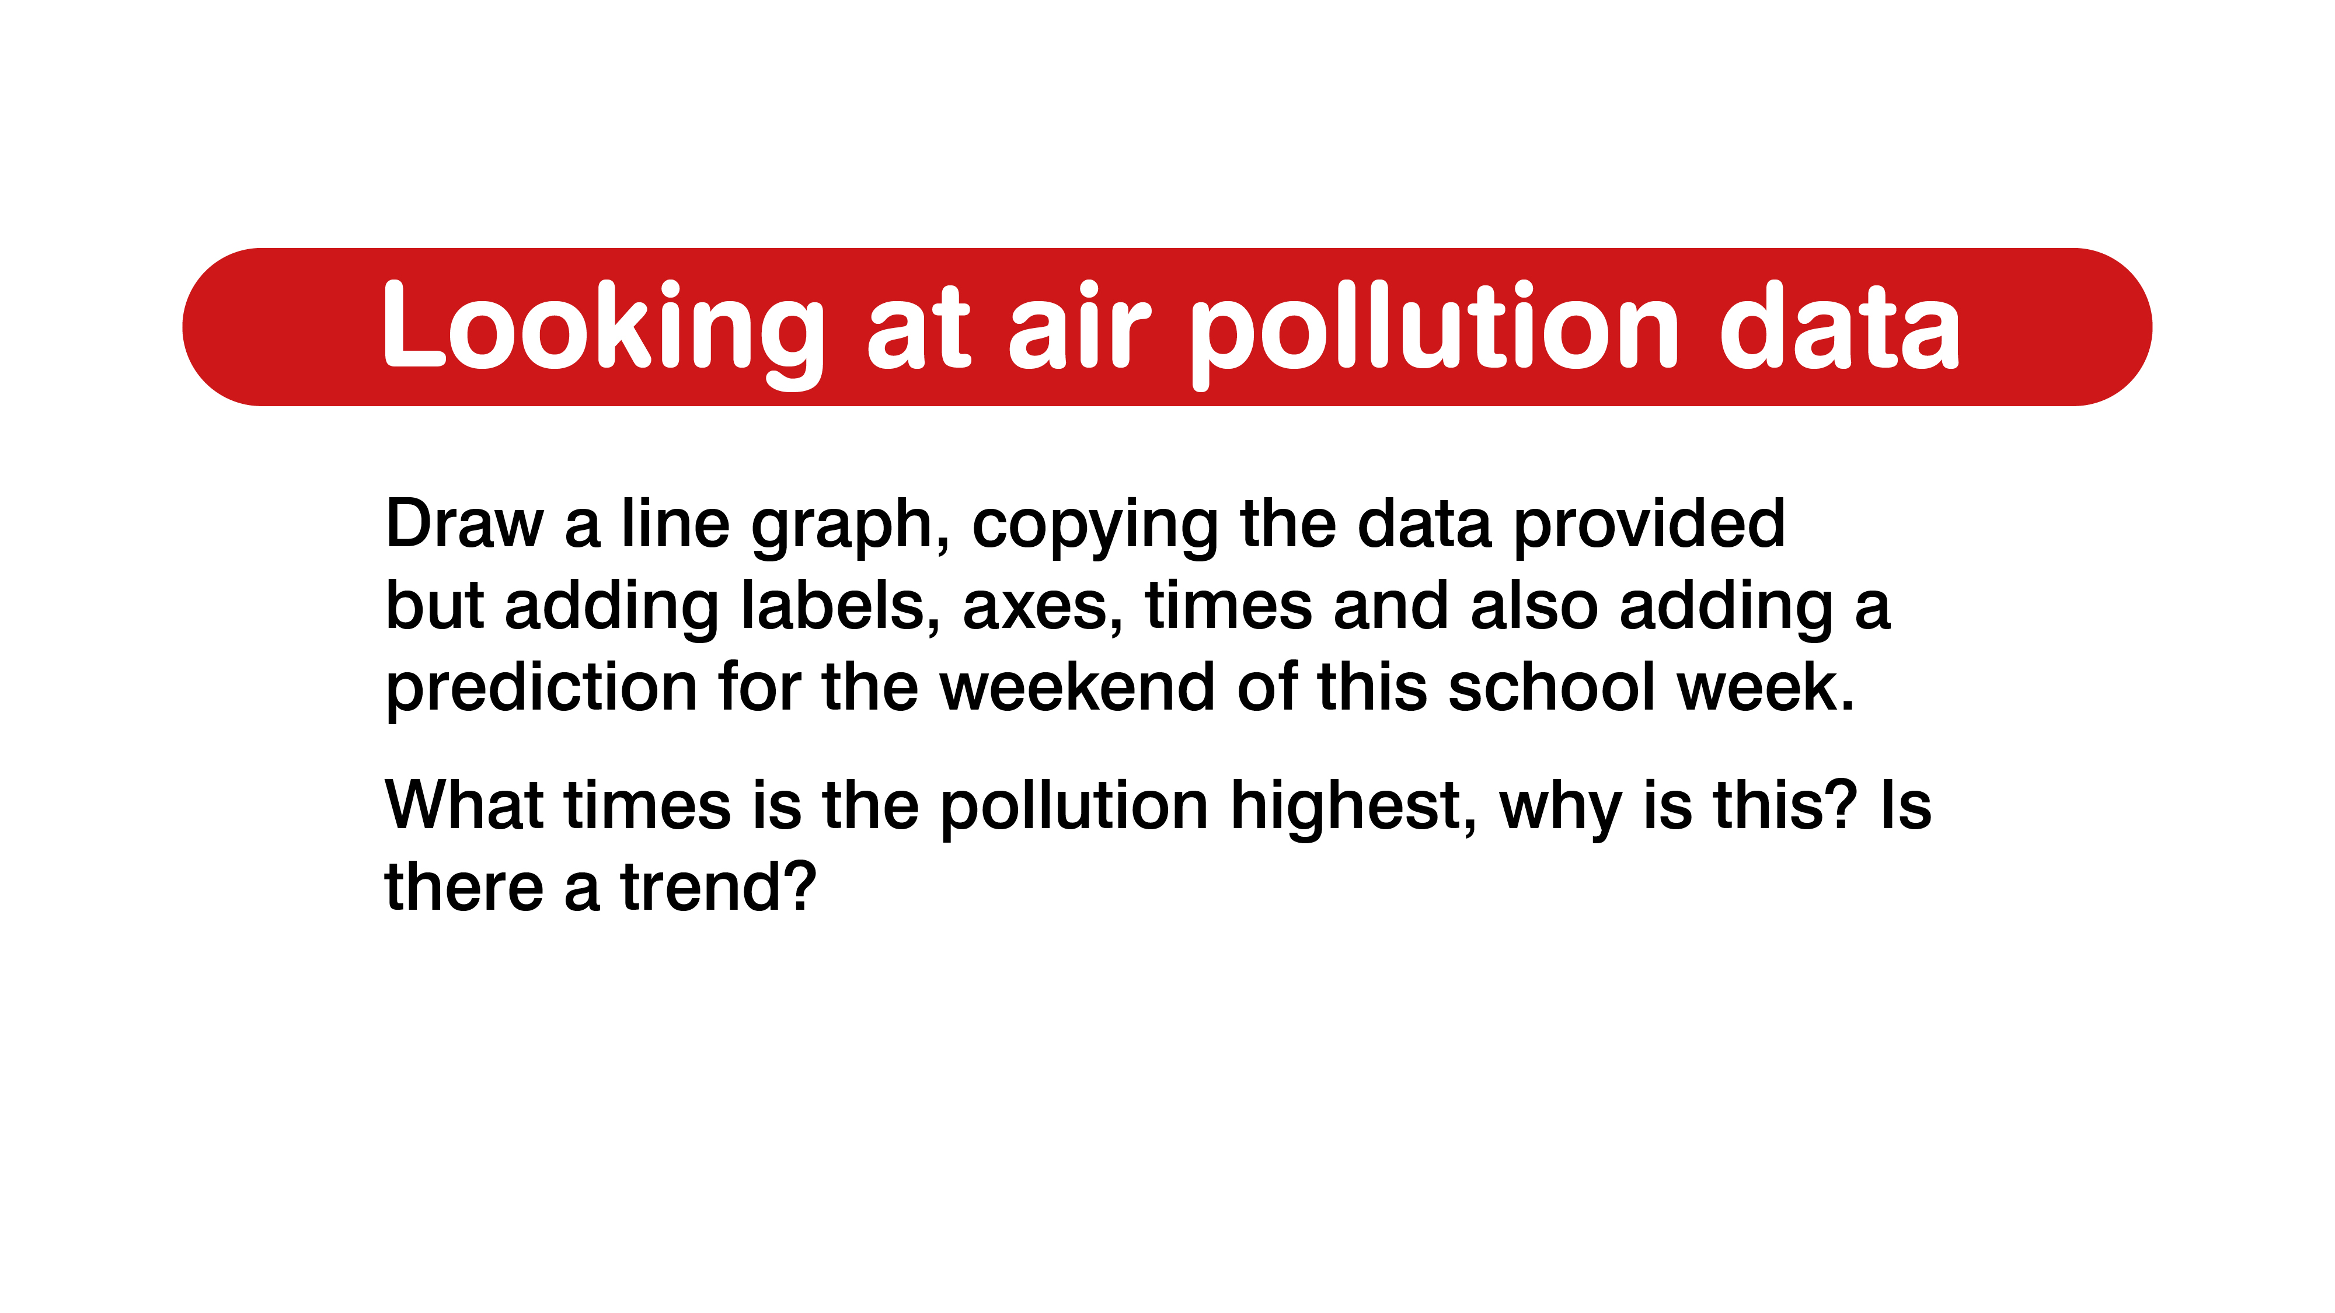
Notes:
Get the students to think about: • What times is the pollution highest, why is this? Is there a trend? • Adding a prediction for the weekend as an extra for those upper KS2 students.

Slide 7
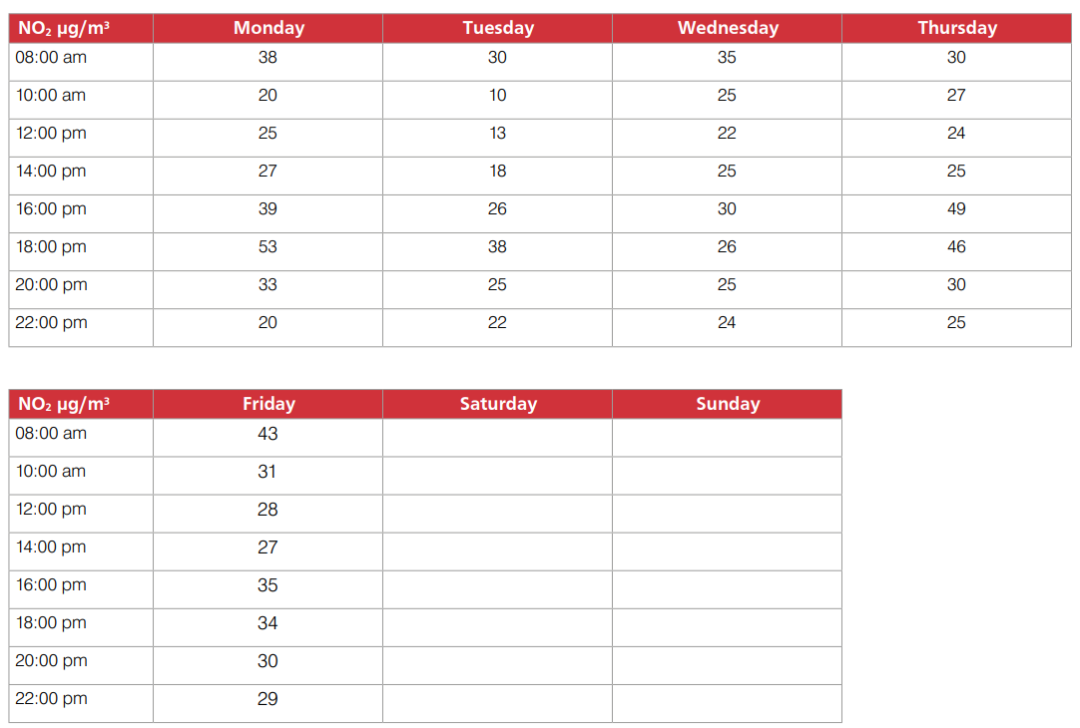

Slide 8
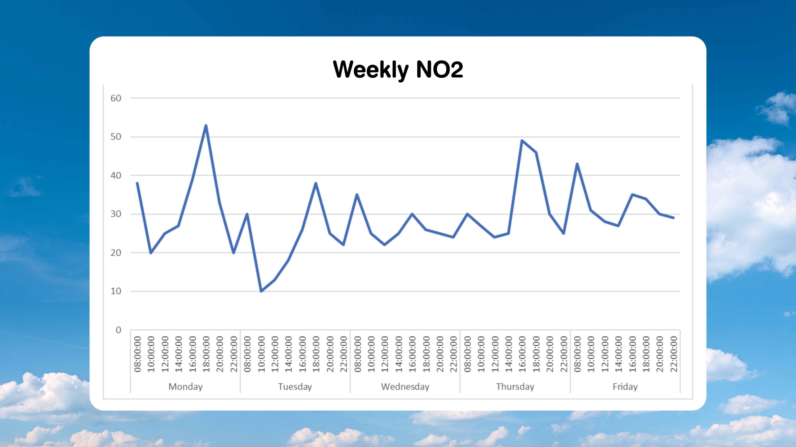
Notes:
Ask the students if they saw any trends or ask them to point out the highest and lowest levels.
Show the students the main trend of the graph and make them aware and allow them to see that there are peaks in air pollution around the times that they come and leave school. The lowest pollution being during the school day.
There is often a peak at 6pm when people leave work.
Ask the students why they think there is higher air pollution at school pick up and drop off times?

Slide 9
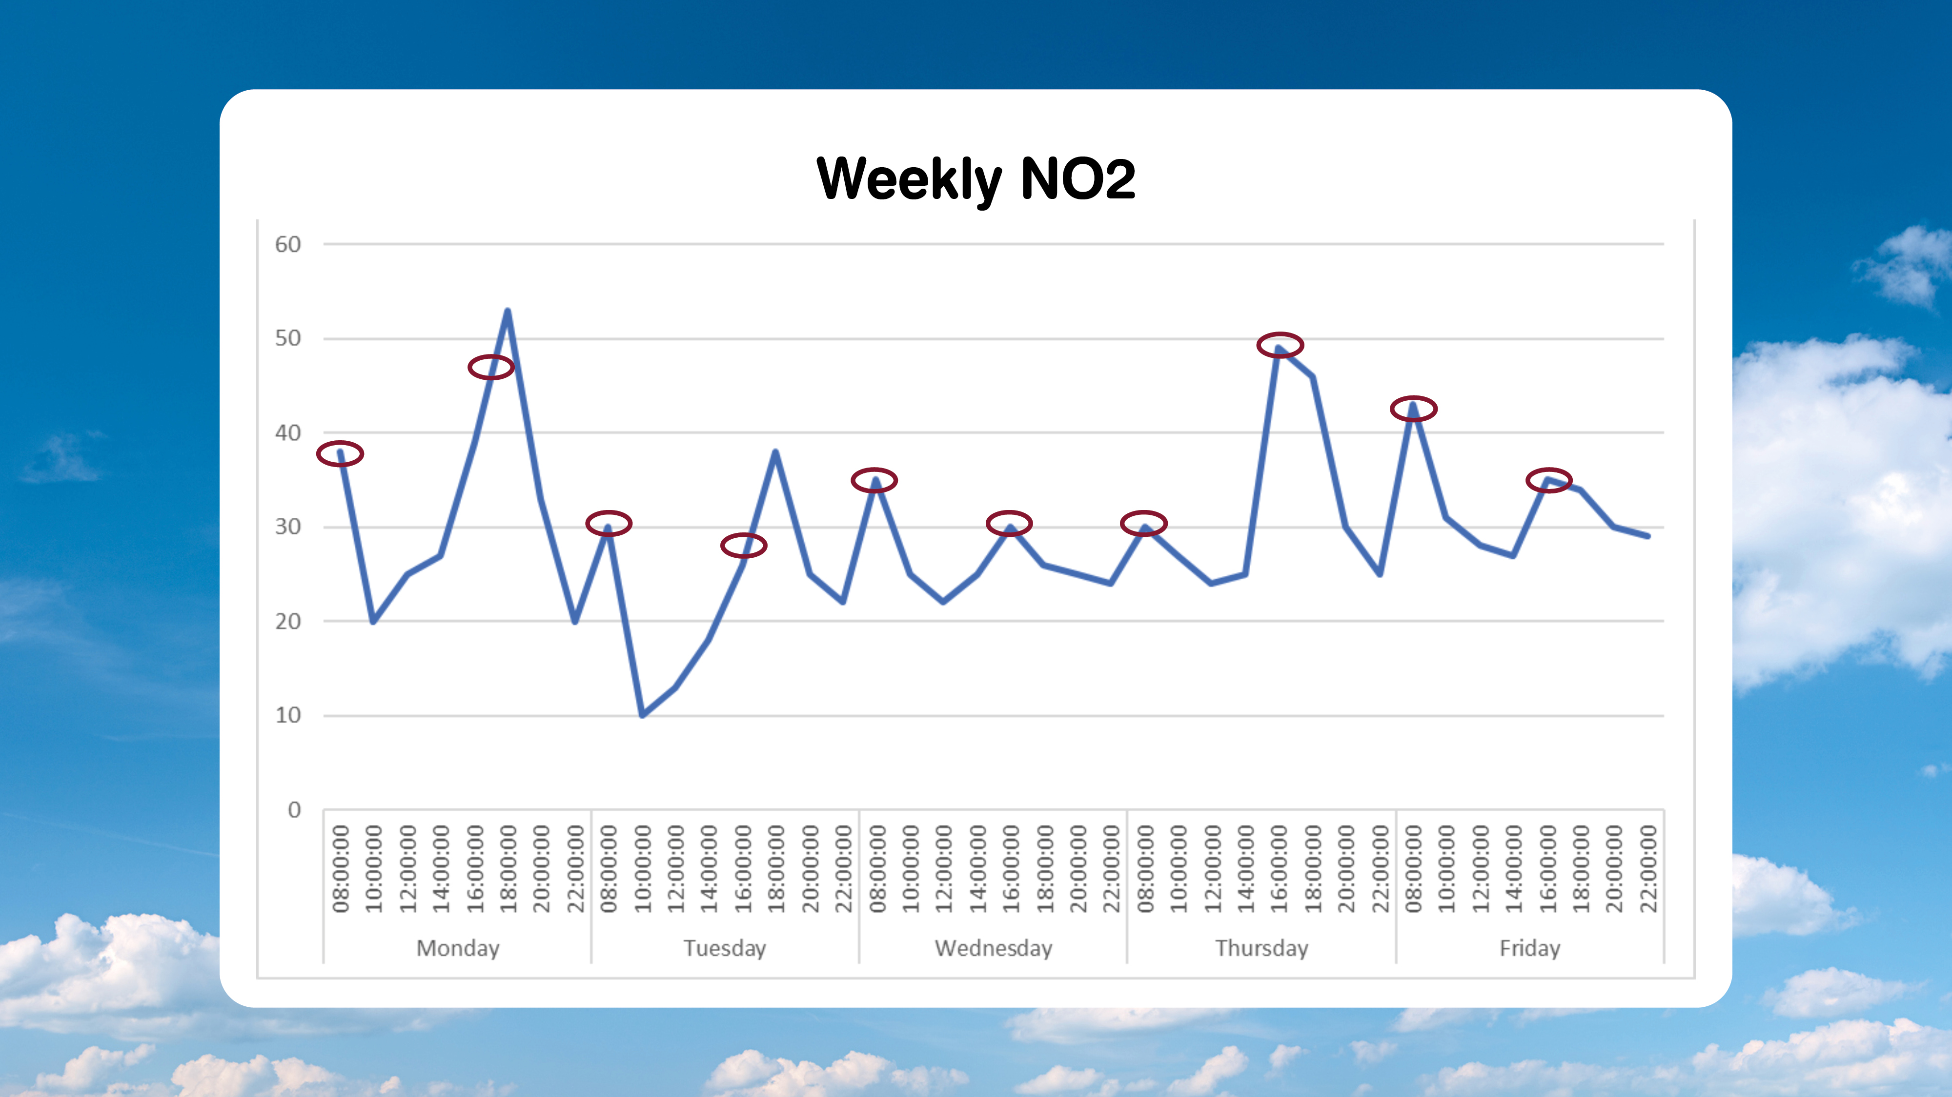
Notes:
Notice the red circles show the school pick up and drop off times and the lines separate the days. The weekend will have no big fluctuations in the pollution but may have slightly higher levels through the day as more people are out and about. Levels around 15 – 30 µg/m3 .

Slide 10
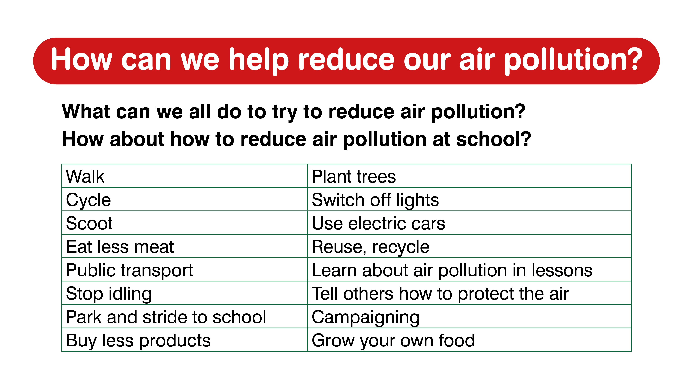
Notes:
Let them also think about how they propose the school can improve their air quality and then how the city of Southampton could improve air quality. What is the difference?
Discussion: What is the one thing each student is going to do as a result of learning about air pollution?

Slide 11


