Slide 1


Slide 2
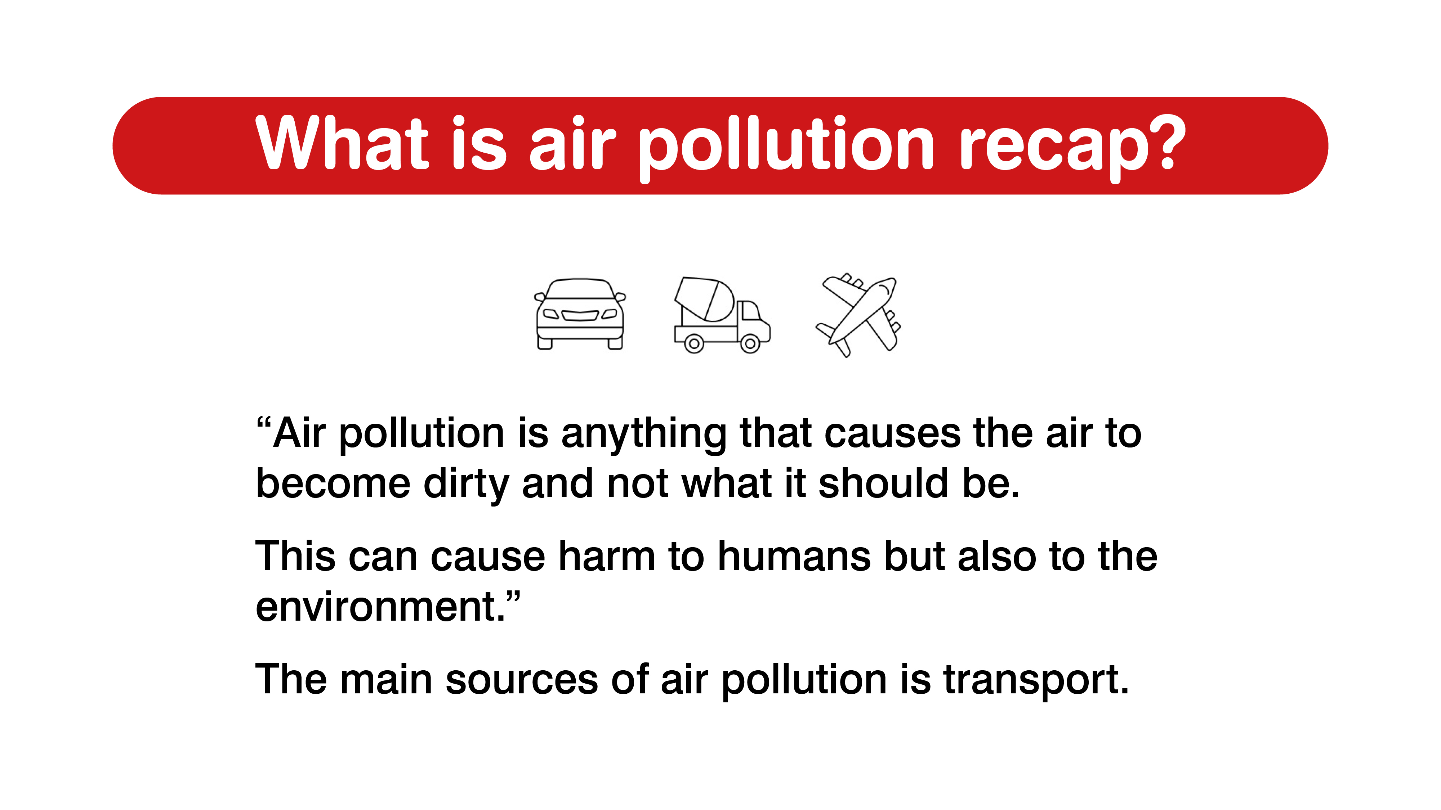
Notes:
What is air pollution?
Ask pupils for suggestions
Then explain “Air pollution is anything that causes the air to become dirty and not what it should be. This can cause harm to humans but also to the environment.”

Slide 3
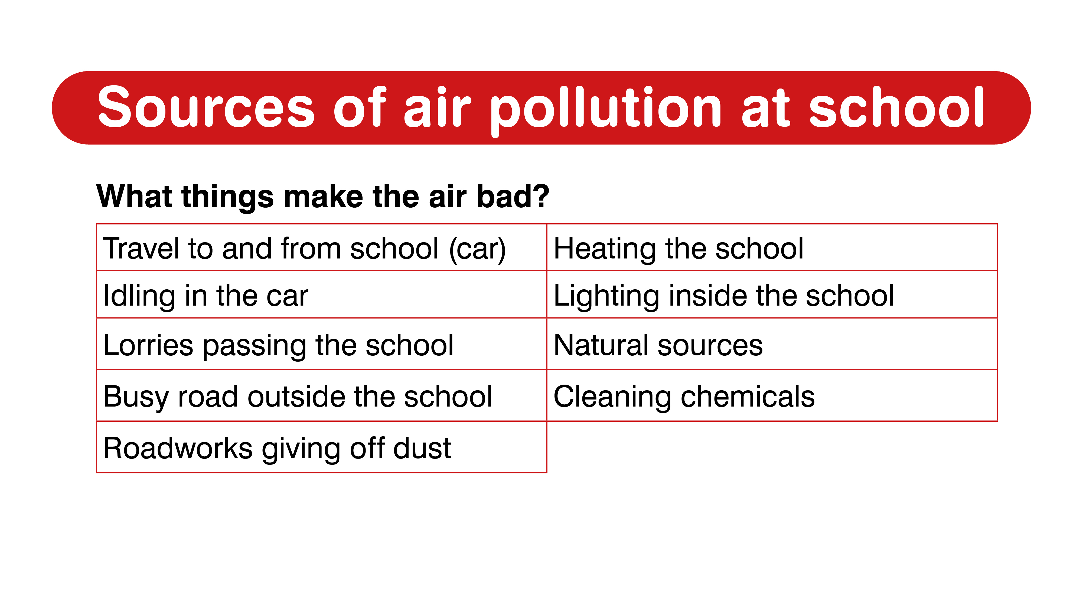
Notes:
Activity:
Get the students to work as a group to think of all the different sources of air pollution at and around the school. Come together and get the students to share their answers and then show the different sources.

Slide 4
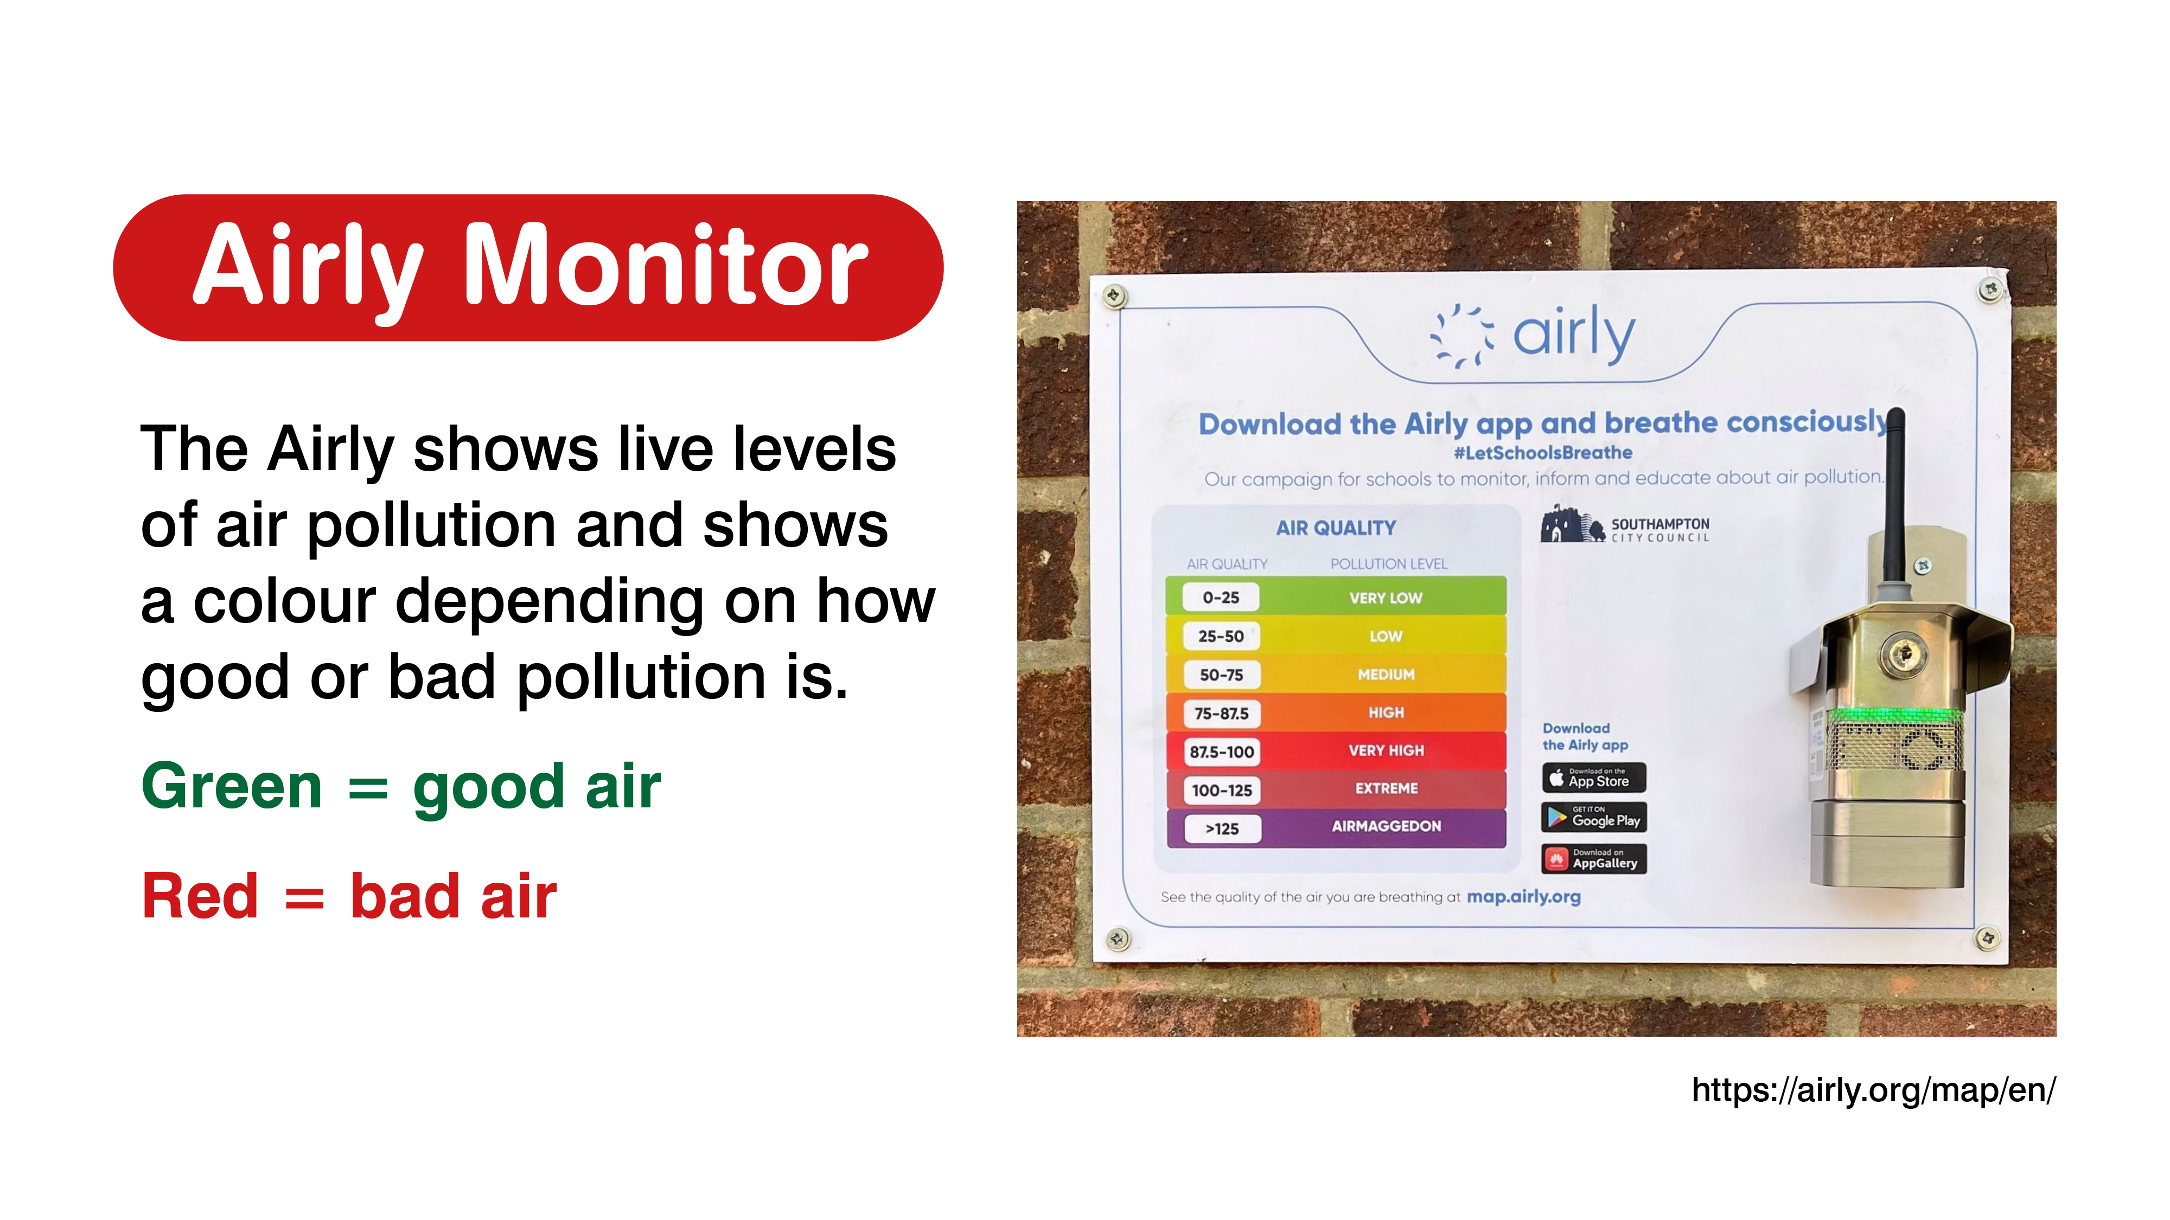
Notes:
PAGE ONLY FOR THESE SCHOOLS (St Johns, Banister, St Annes, Redbridge P, Redbridge C, St Mary’s, Sholing Junior, Bassett green, Freemantle, Maytree infants) – delete if you have a diffusion tube and don’t have this sensor
Airly air quality monitor:
Introduce the Airly as an air quality sensor.
It shows live levels of air pollution and shows a colour depending on how good or bad pollution is.
Show the students where the Airly has been located in the school (either in person or by picture and explanation).
Look at the Airly map together on a screen and look through the colours of pollution data for the past 24 hours of data. Access to the Airly map is here: https://airly.org/map/en/.
Explain that:
This machine measures the pollution mostly made by road transport.
Ask the students where they think the best place to put the sensor is if they want to measure an area students spend most of their time in? How about an area they think will be most polluted?
The ideal places would be the school playground or the main entrance and near the main road by the school

Slide 5
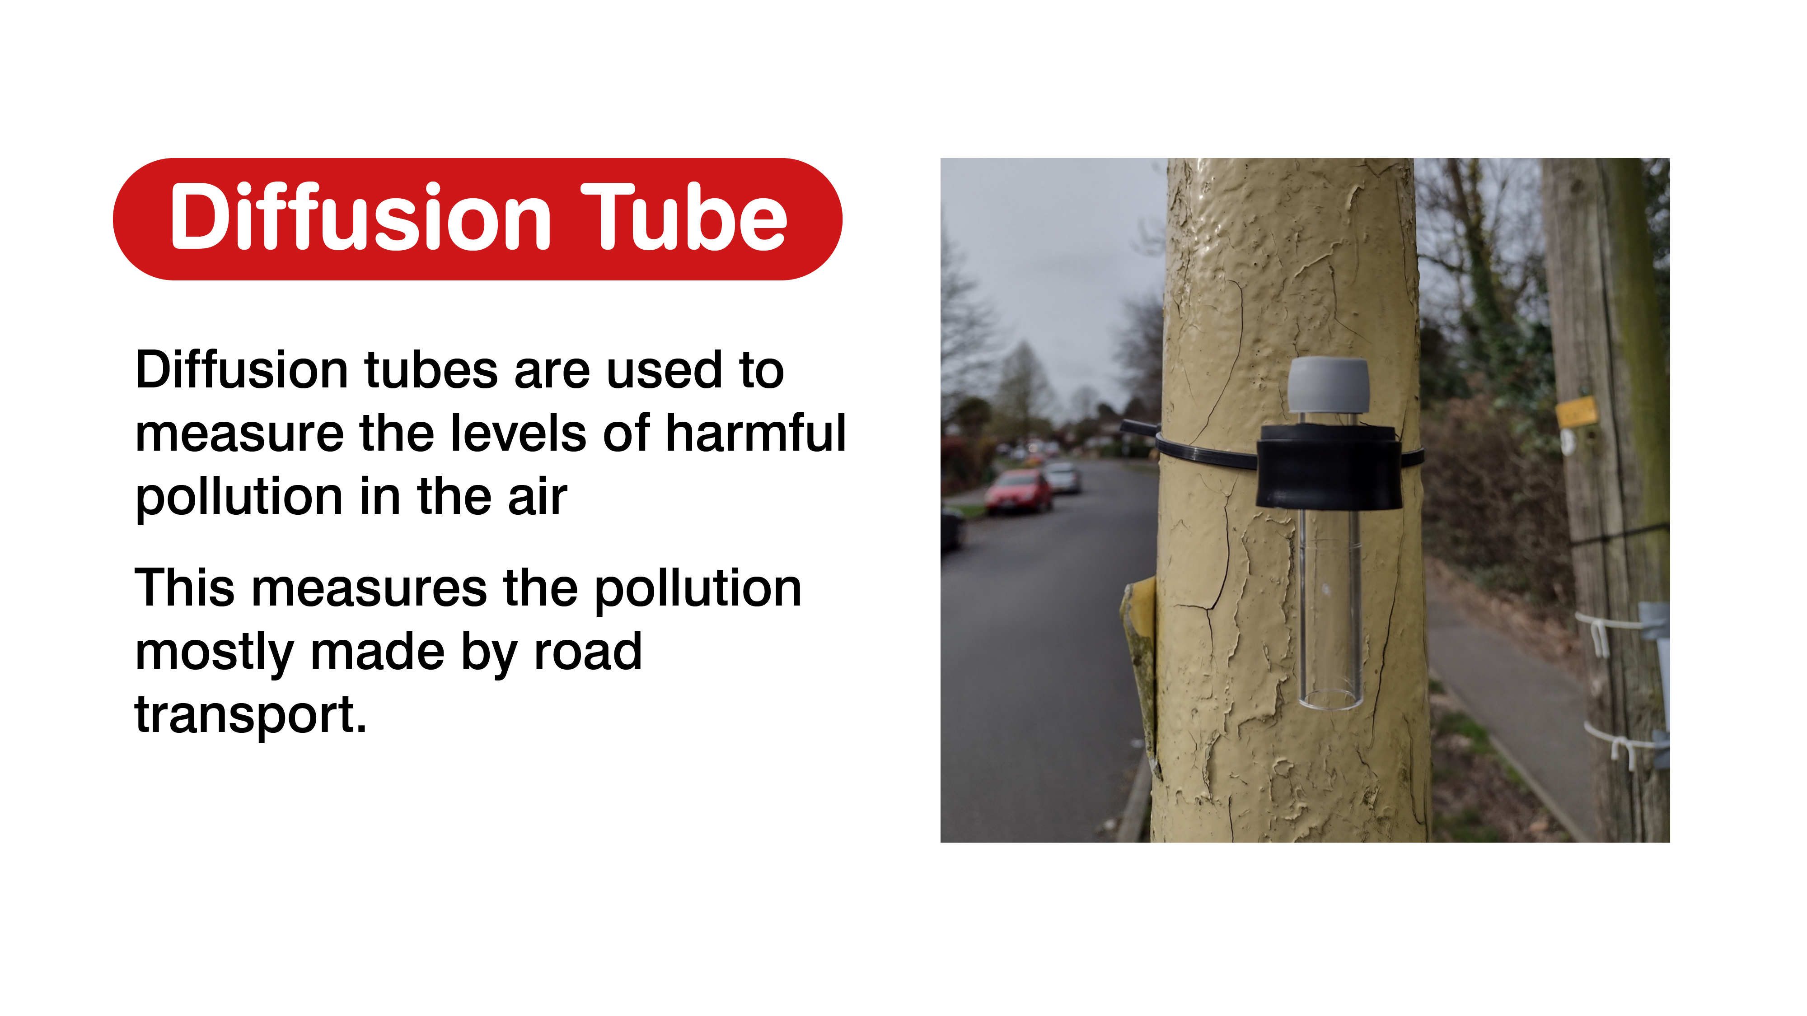
Notes:
PAGE ONLY FOR SCHOOLS that don’t have a diffusion tube
Diffusion tubes:
Introduce the diffusion tubes and explain to the students that they’ll be used to measure the levels of nitrogen dioxide around their school.
1. Explain that Diffusion tubes are used to measure the levels of harmful pollution in the air, by use of a sampling tube and a filter.
2. This measures the pollution mostly made by road transport.
3. Ask the students where they think the best place to put the tube is if they want to measure an area students spend most of their time in? How about an area they think will be most polluted?
4. The ideal places would be the school playground or the main entrance and near the main road by the school.

Slide 6
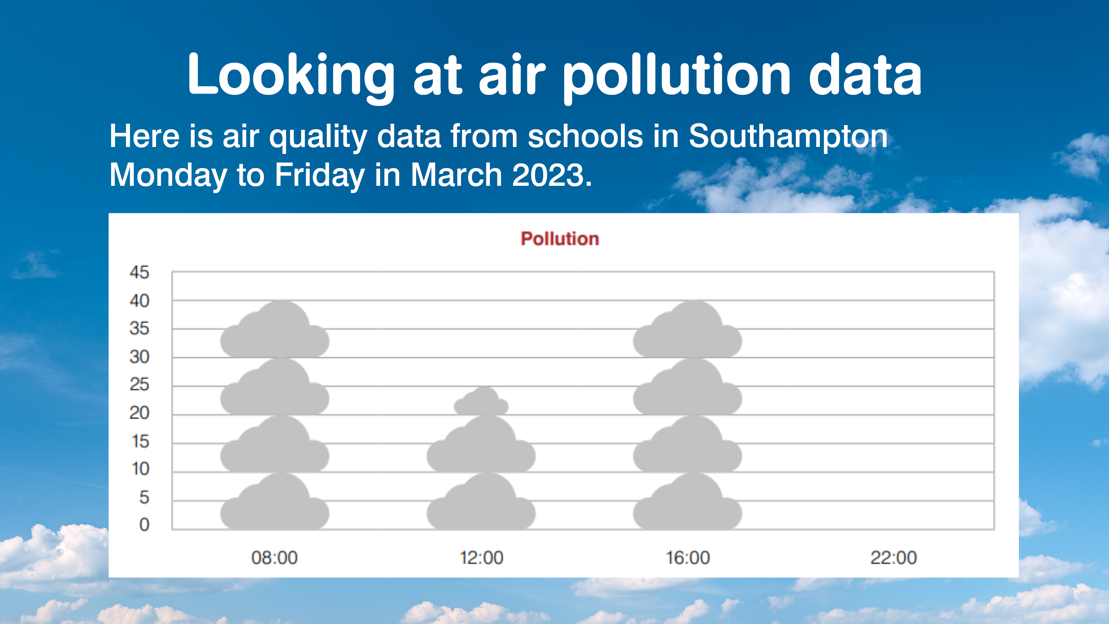
Notes:
First show the pictogram without annotation and see if any students see any trends or ask them to point out the highest and lowest levels.
Show the students the main trend of the graph and make them aware and allow them to see that there are peaks in air pollution around the times that they come and leave school. The lowest pollution being during the school day.
Ask the students why they think there is higher air pollution at school pick up and drop off times?
Ask the pupils how many clouds of pollution they think there would be at 10pm? The pollution level at 10pm will be lower than mid-day – say 2 or less clouds

Slide 7
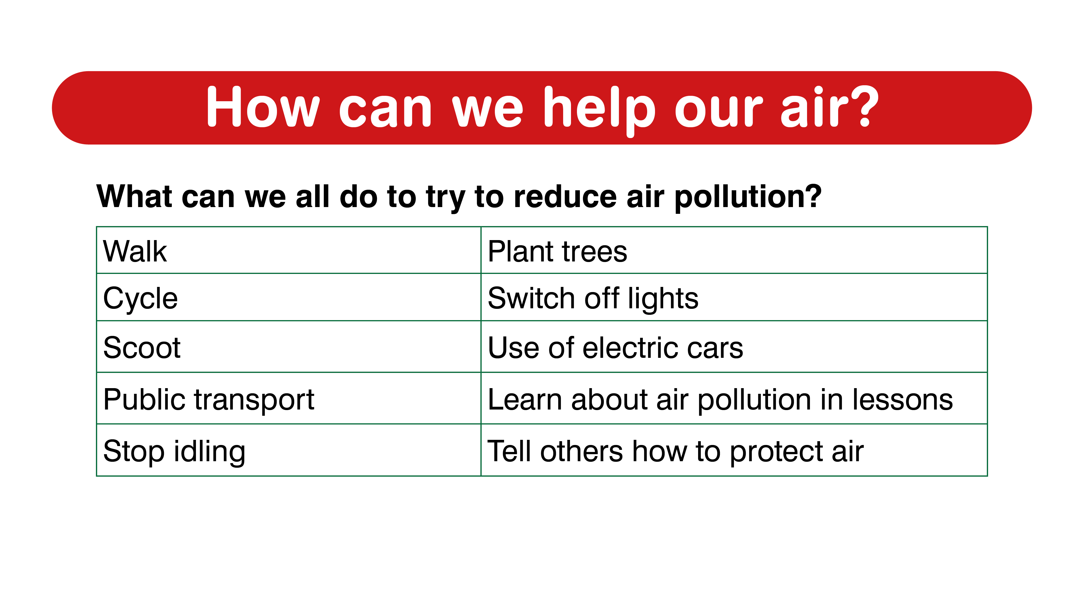
Notes:
Helping the air quality at school is about getting everyone at school involved and working to make the changes. Making school a green and clean area.
Draw a picture of your school with very clean air

Slide 8


