Slide 1
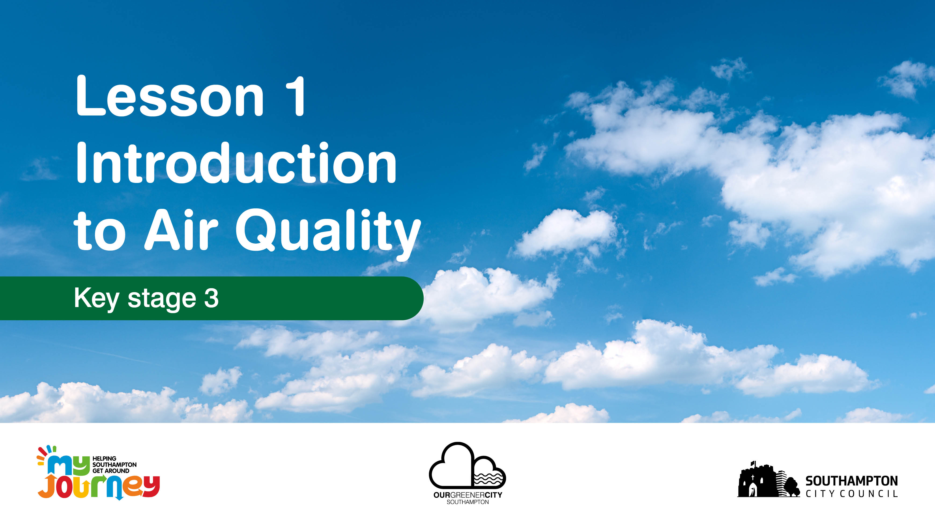

Slide 2
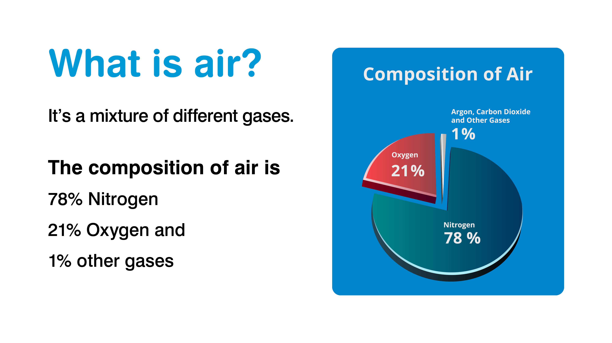
Notes:
What is air pollution?
Ask pupils for suggestions
Then explain “Air pollution is anything that causes the air to become dirty and not what it should be. This can cause harm to humans but also to the environment.”

Slide 3
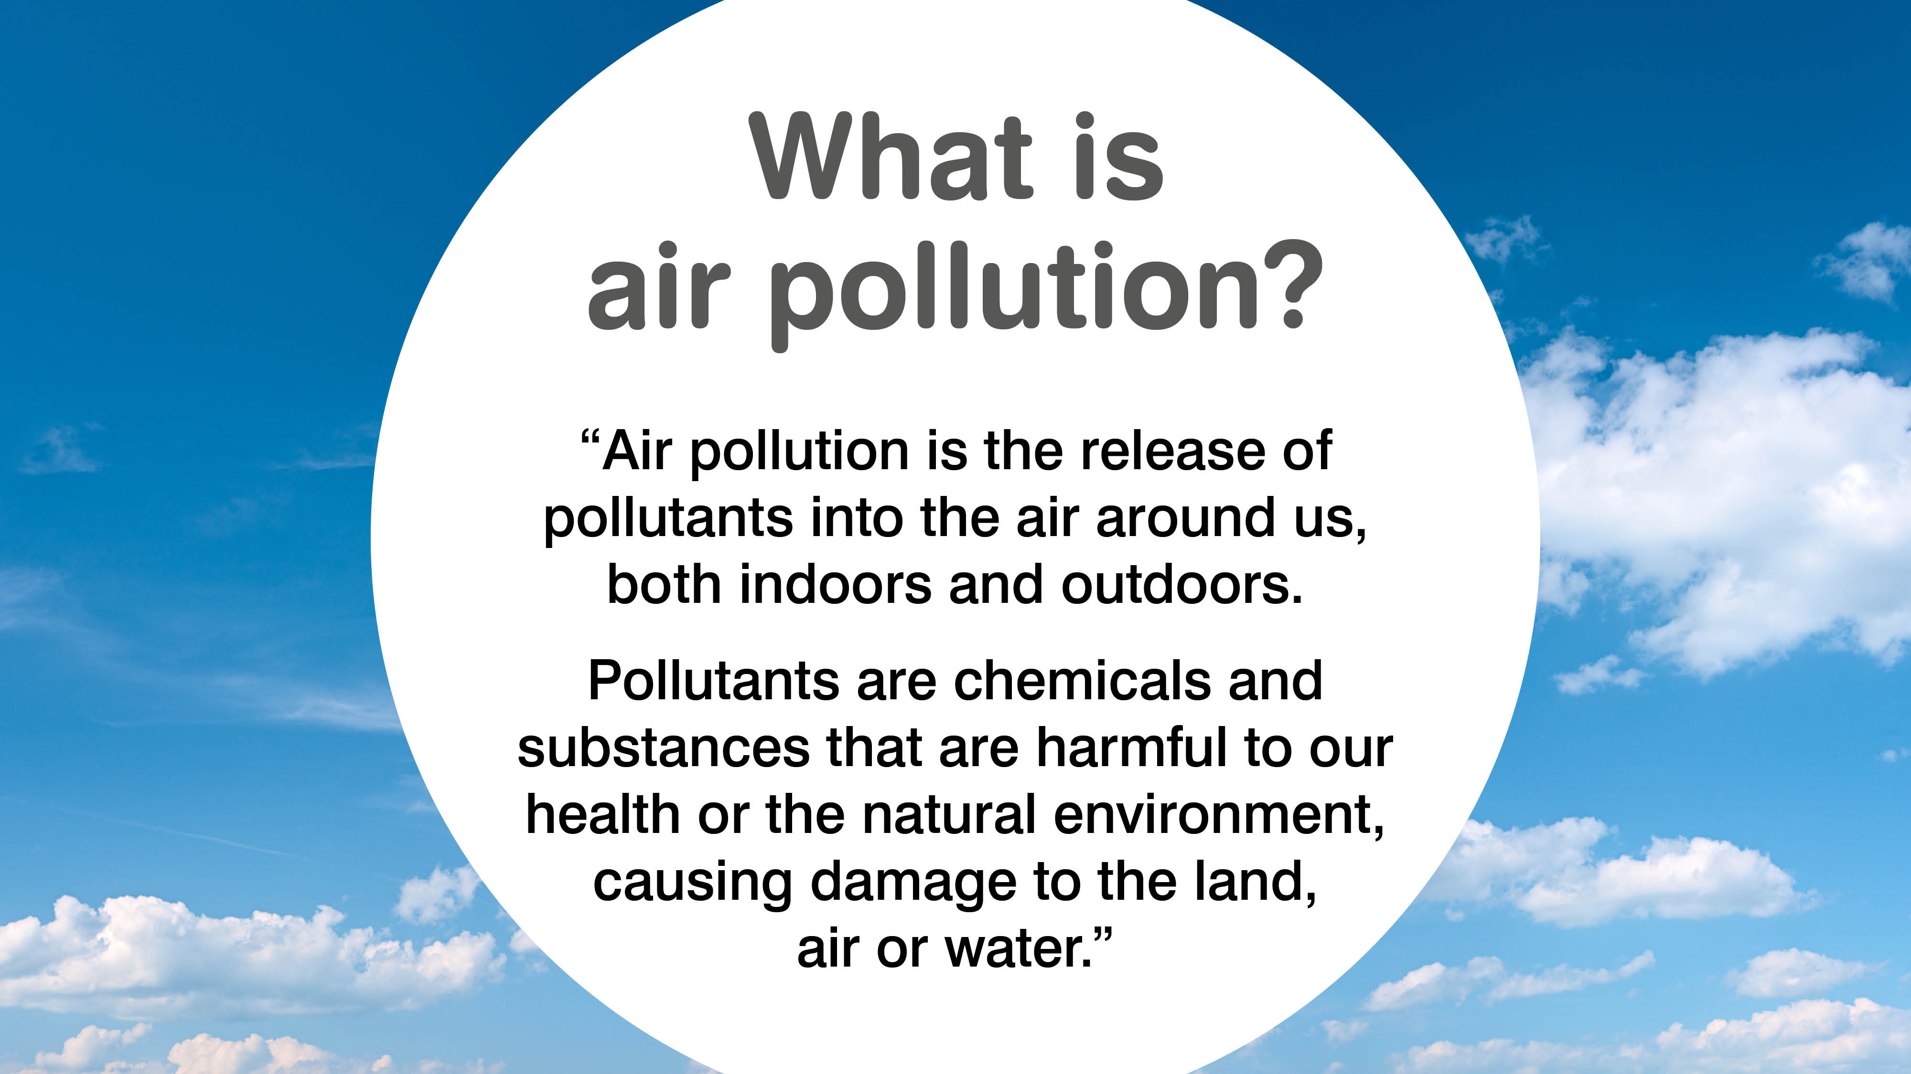
Notes:
What is air pollution?
Ask pupils for suggestions
Then explain “Air pollution is anything that causes the air to become dirty and not what it should be. This can cause harm to humans but also to the environment.”

Slide 4
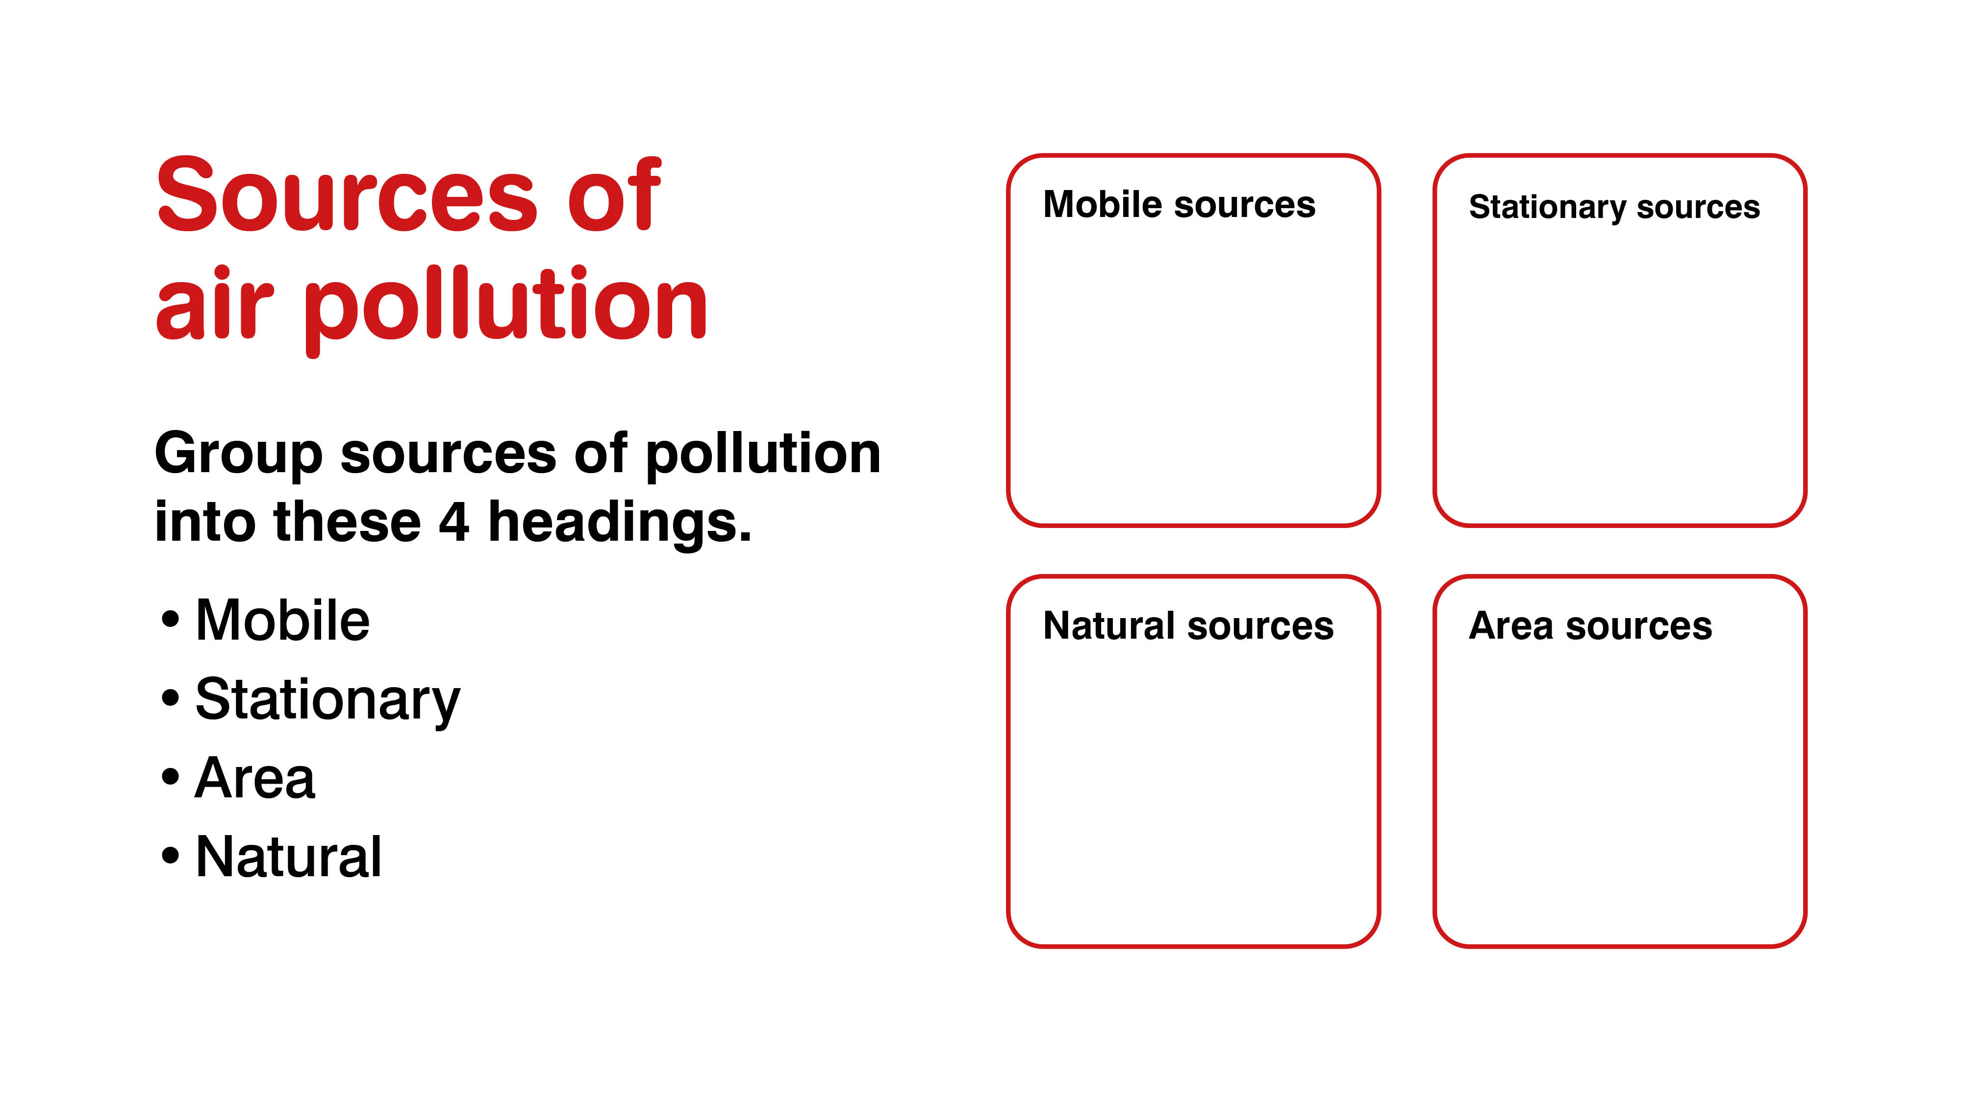

Slide 5
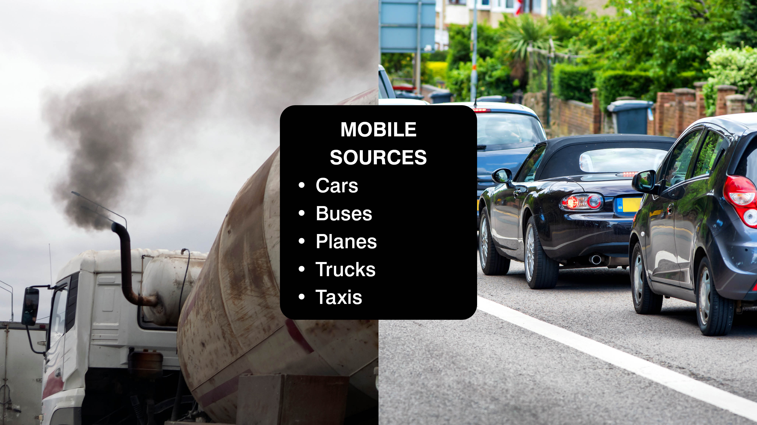

Slide 6
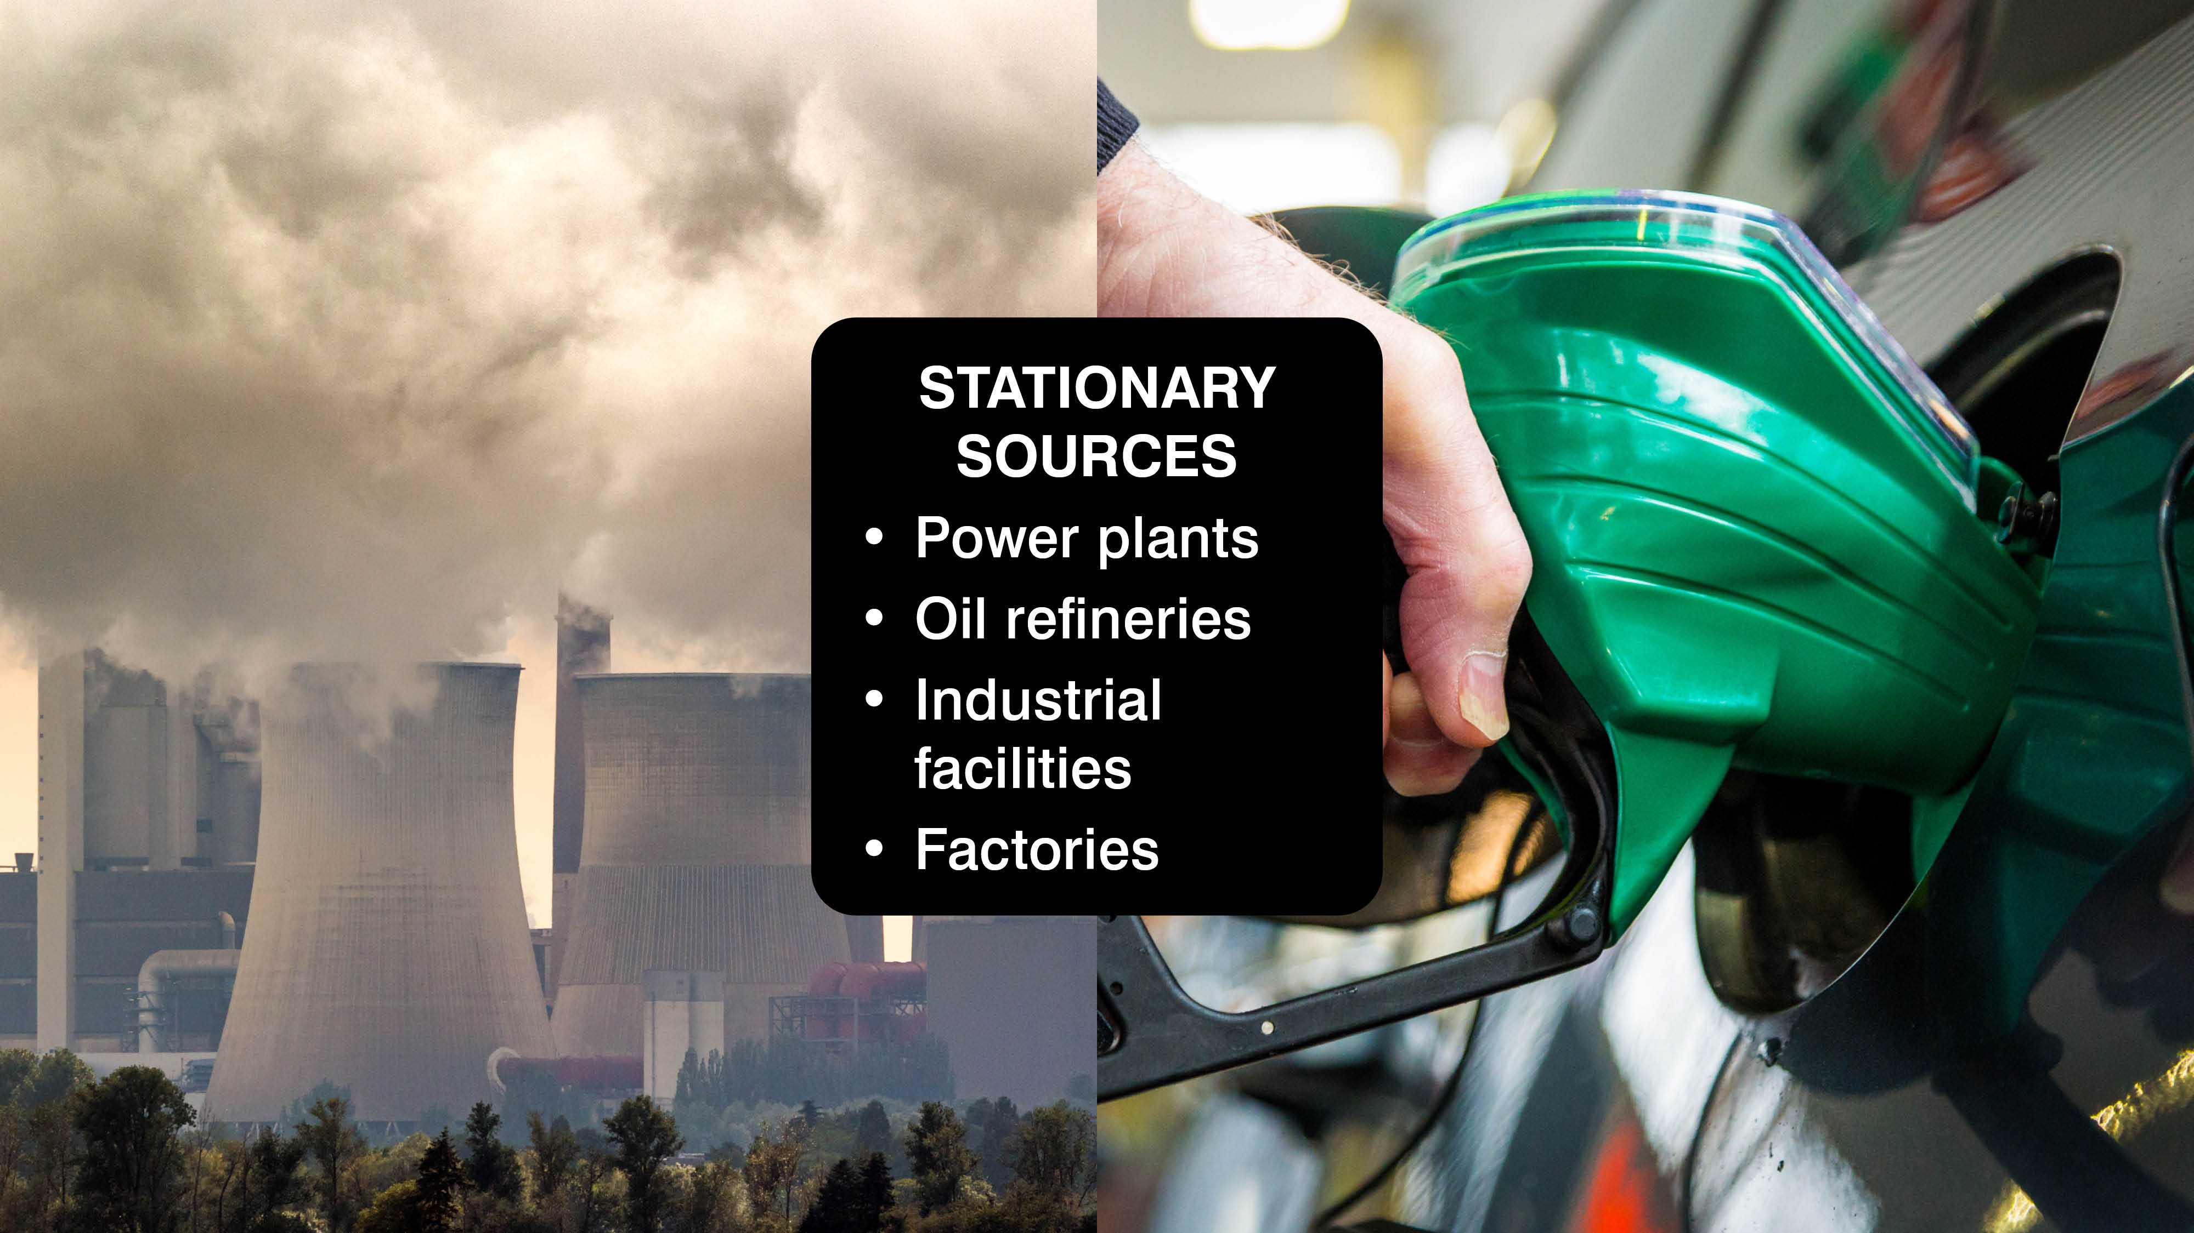

Slide 7
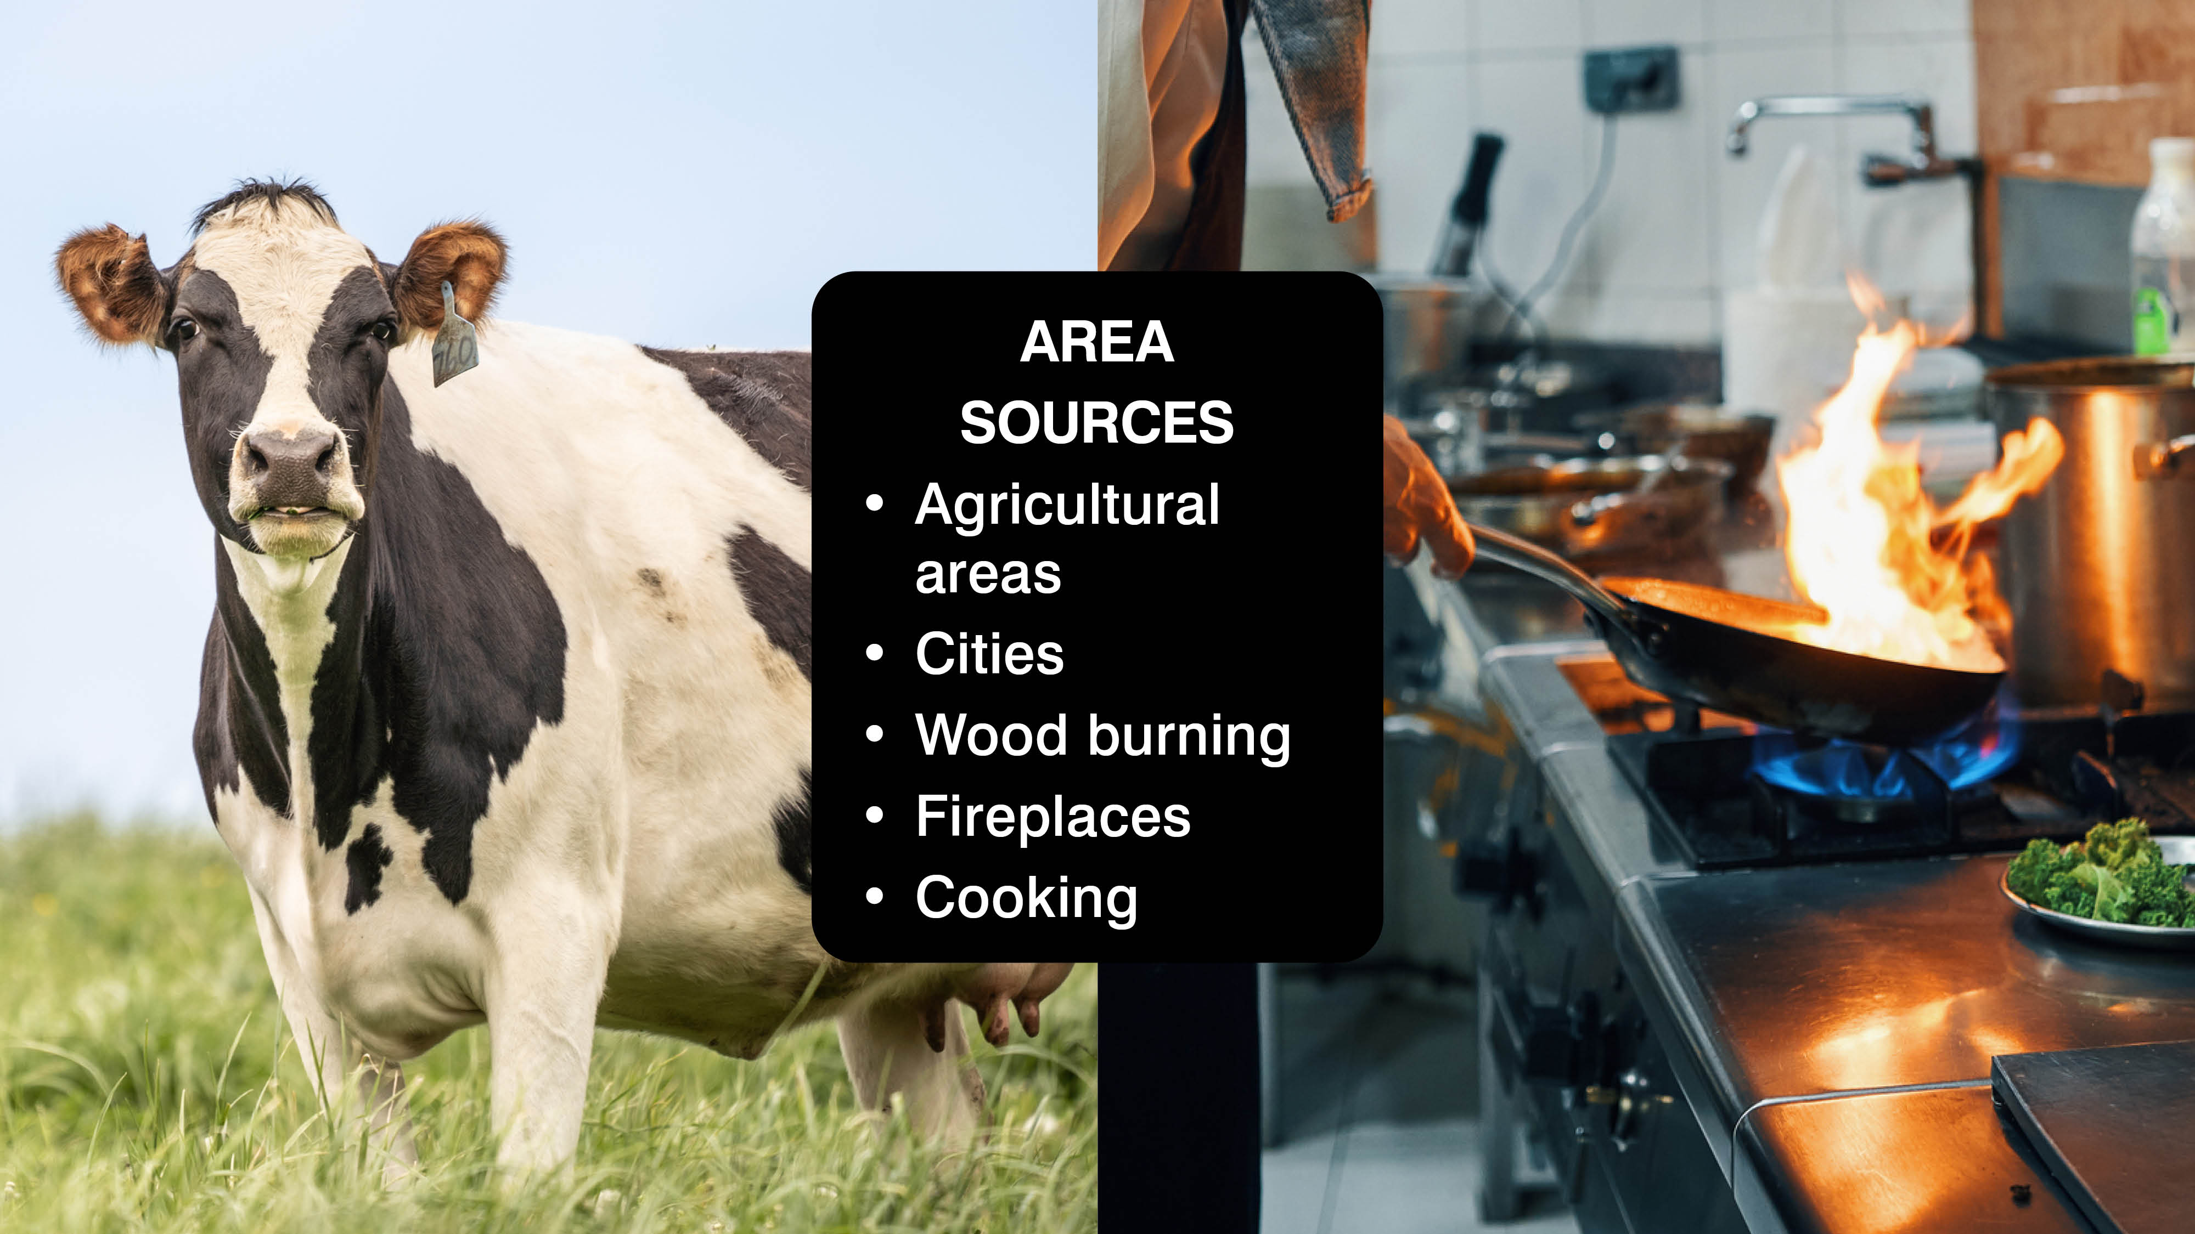
Notes:
Get the students to circle the symbol of the biggest source of pollution.
After they have circled their response as some students to say which one they decided.
Then go on to explain – “The most common way for air to become polluted is through human actions like burning fuel. Everyday activities like; driving a car, cooking or lighting a fire can cause pollution. Vehicle emissions, especially in a city like Southampton, are the biggest source of air pollution.”
Add the remaining answers onto the board to create a mind map of answers.
• Mobile sources – such as cars, buses, planes, trucks, and trains
• Stationary sources – such as power plants, oil refineries, industrial facilities, and factories
• Area sources – such as agricultural areas, cities, and wood burning fireplaces
• Natural sources – such as wind-blown dust, wildfires, and volcanoes

Slide 8
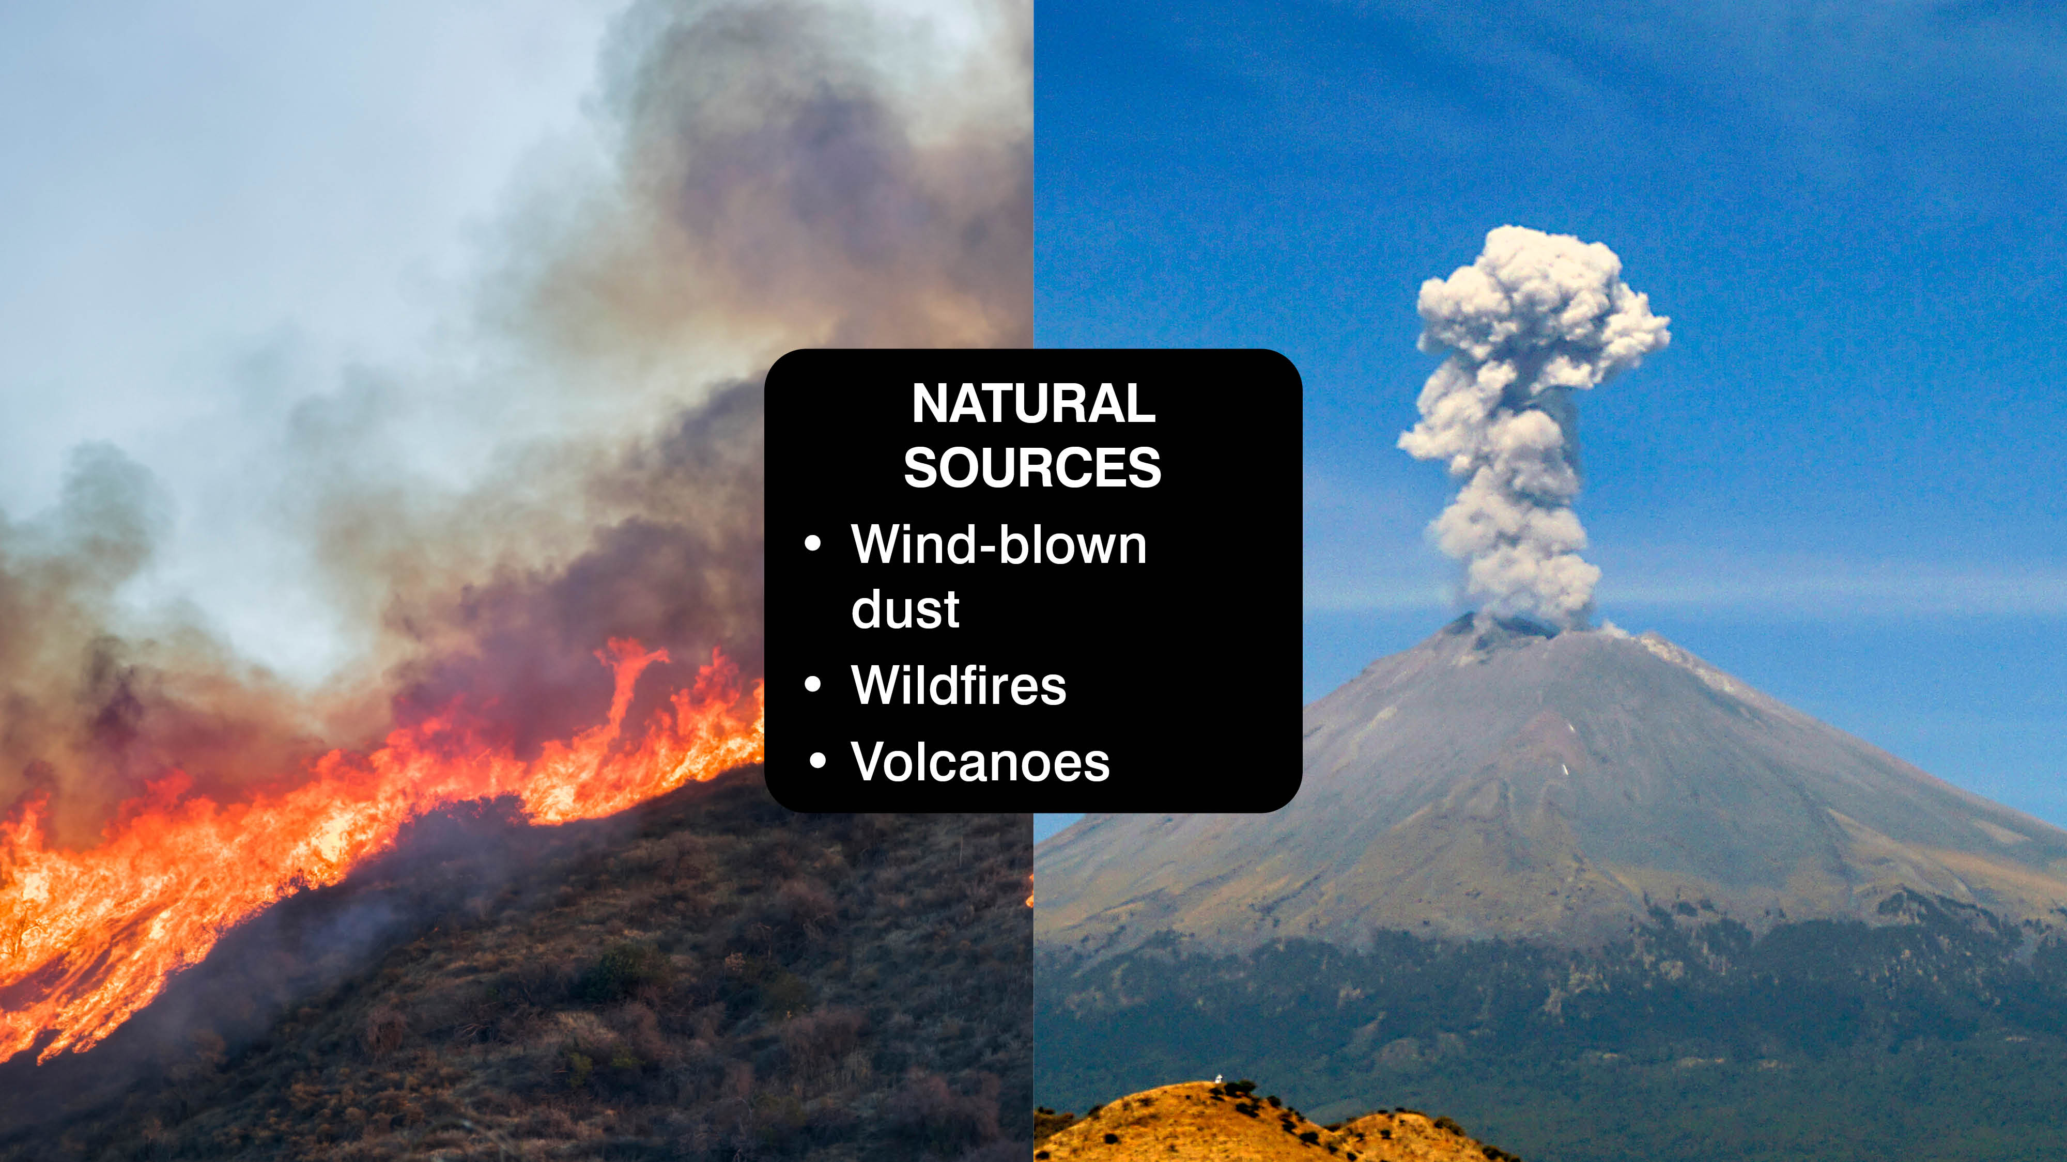
Notes:
Why do humans need to survive?
Animals as well as humans need air, water, shelter and food to survive.
All living things need oxygen to breath and survive.
Our bodies use it to turn the fuel from our food into energy.
Without trees we wouldn’t get enough oxygen.
Activity: Ask the students to jog on the spot for a minute and ask them to describe what they notice about their breathing. Is it faster?
Explain that we need clean air to be able to stay fit and healthy and be able to breathe easier.
With polluted air this becomes harder.
Why is air pollution bad?
Ask the students to stand up if they know someone (including themselves) who has asthma or problems with their breathing.
Ask pupils how air pollution affects them and their family? Ask the children if they or someone they know has asthma or other breathing problems. Is it more difficult to breathe on some days more than others? Is it more difficult to breathe or do you cough near busy roads? How do you think pollution affects this?
Explain that if a child breathes high levels of air pollution over a long period of time, they are more at risk of:
• Their lungs not working as well as they grow older.
• Developing asthma during childhood or as an adult - and if they have asthma already, air pollution can make it worse.
• Finding it harder to breath or having a regular cough

Slide 9
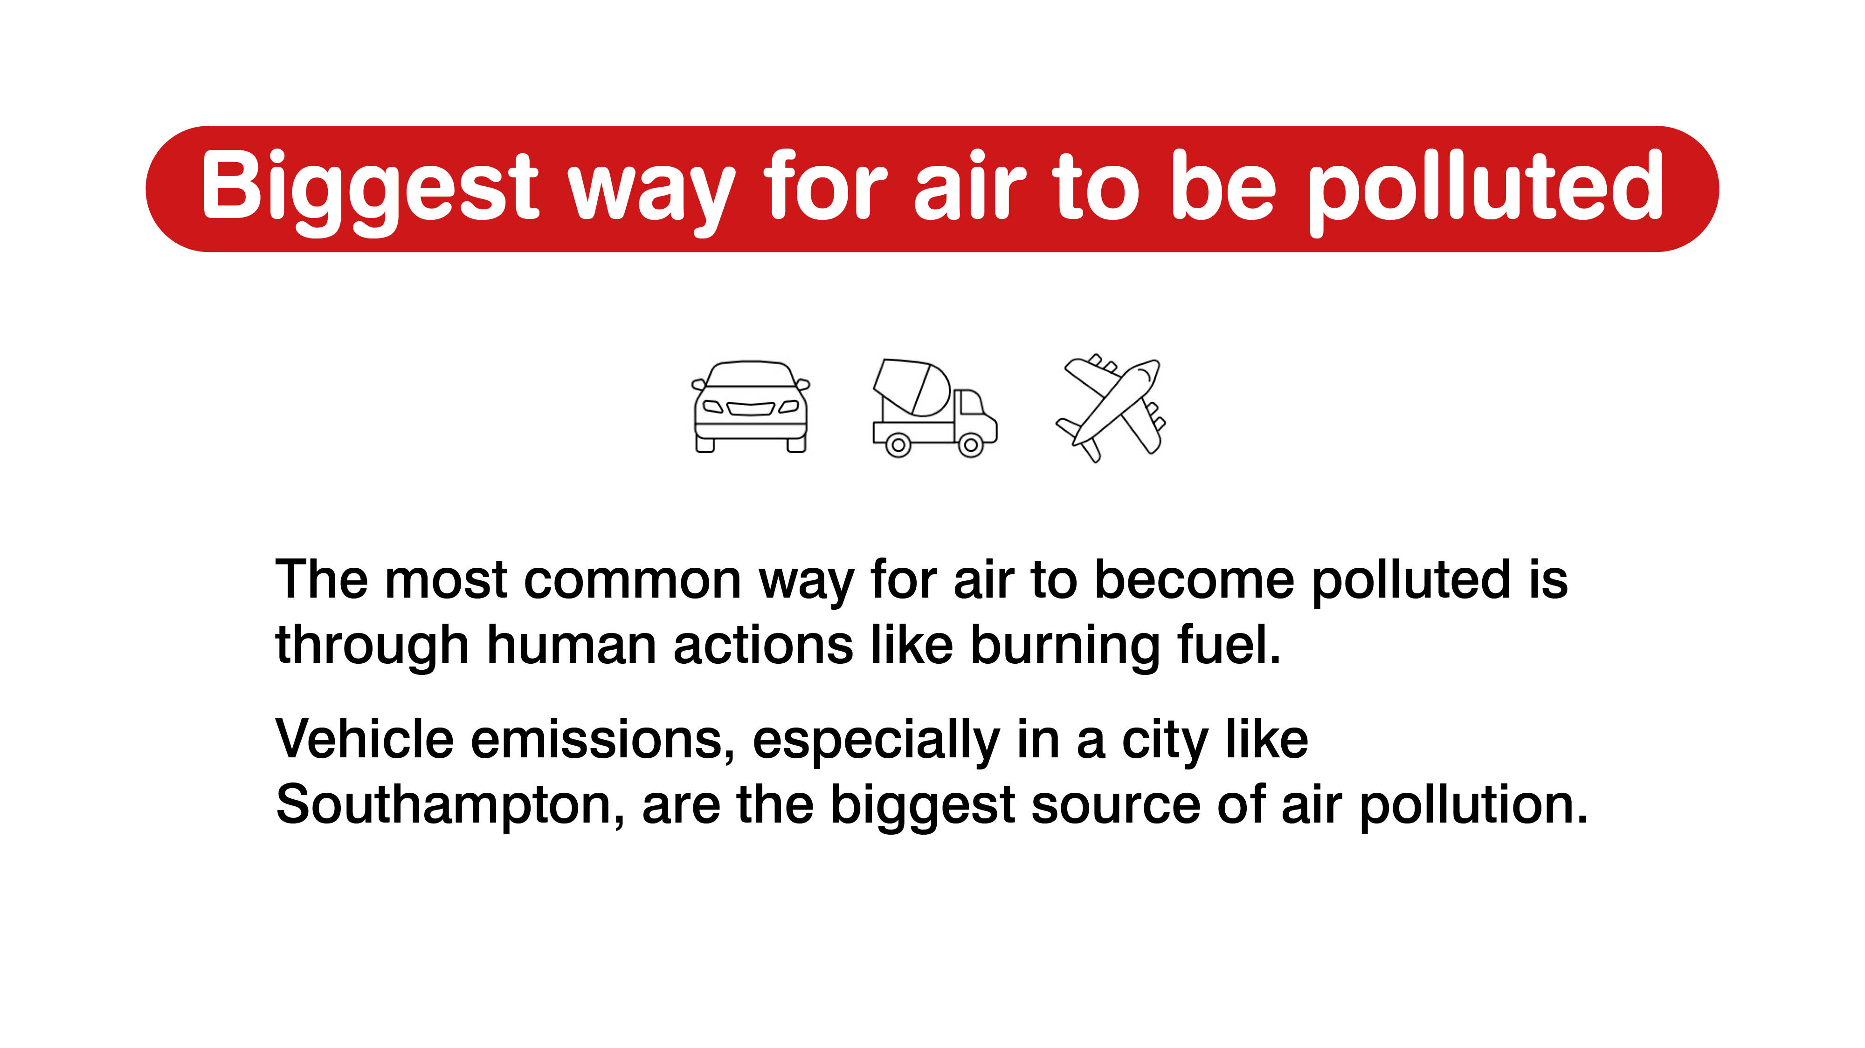

Slide 10
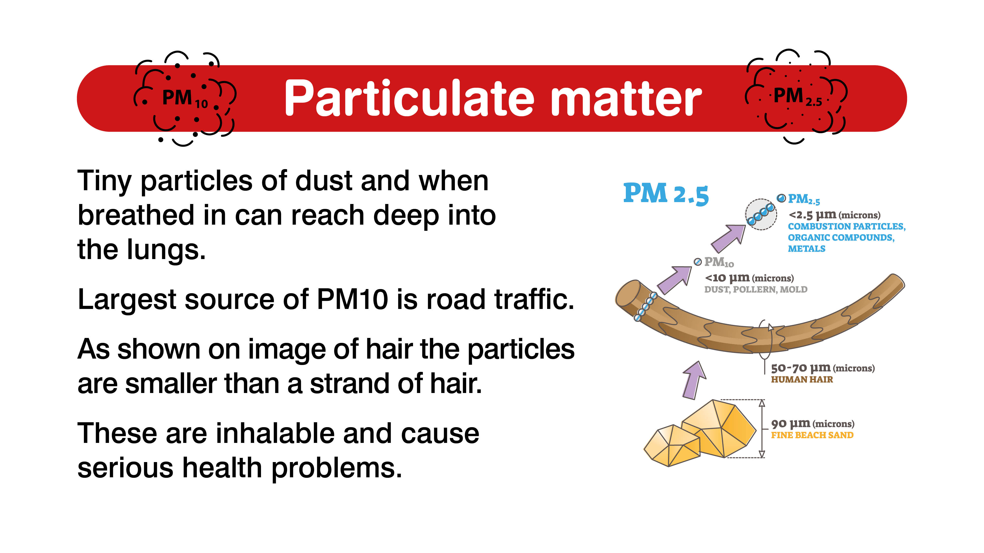

Slide 11
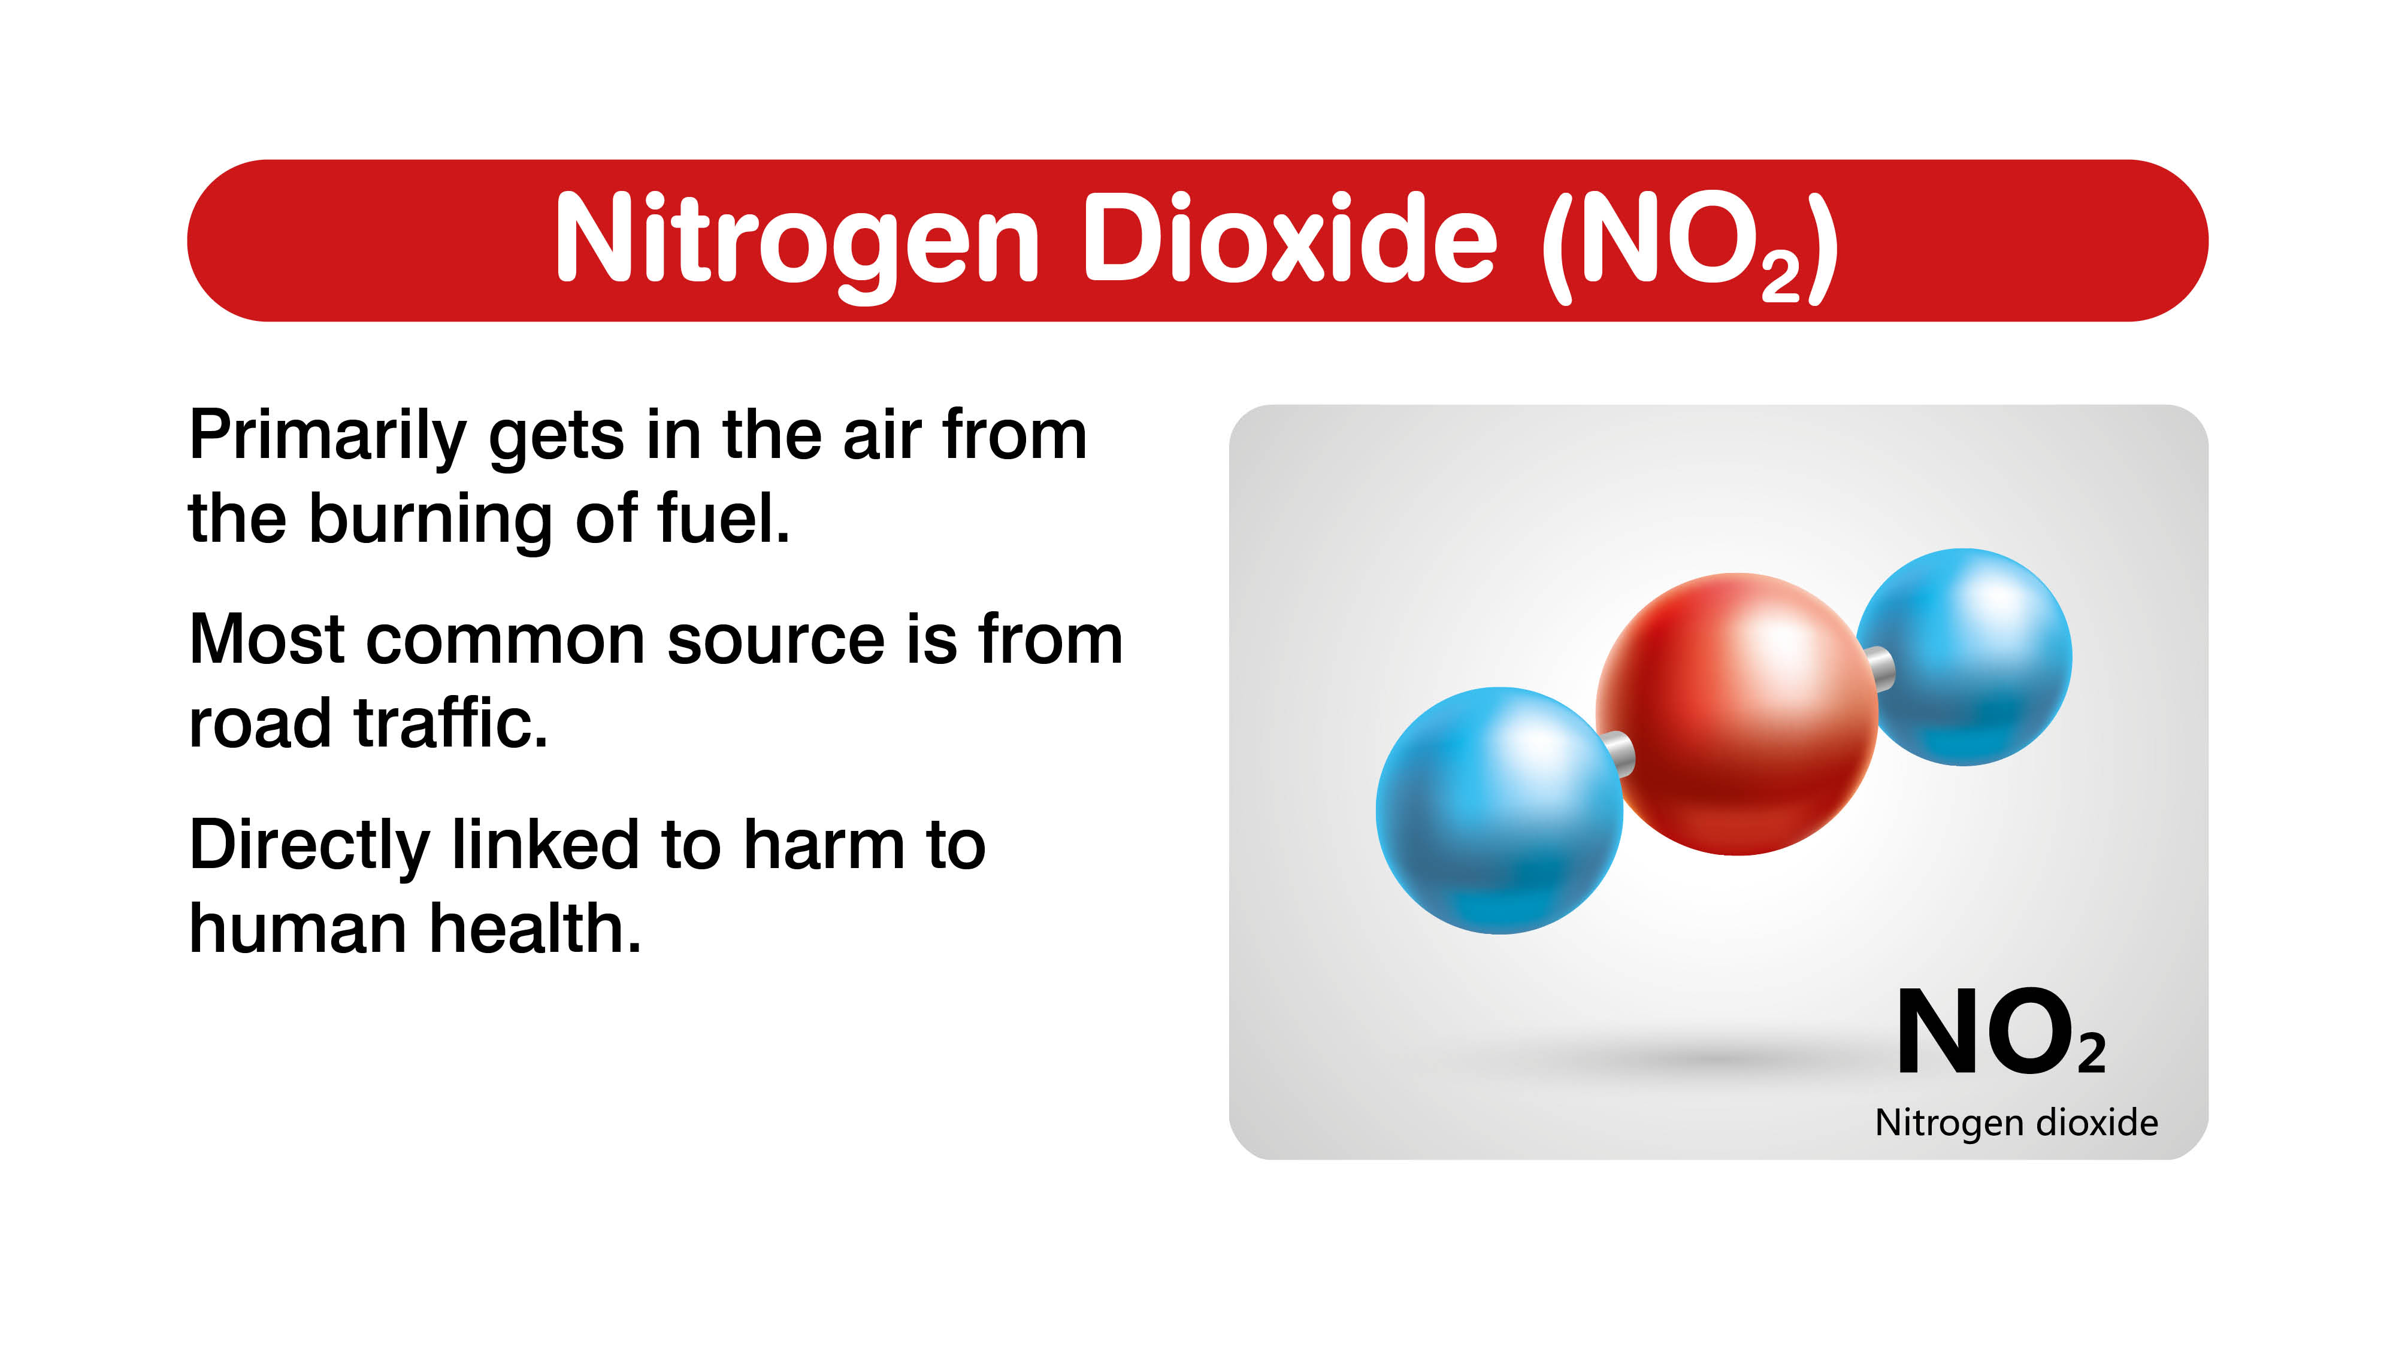

Slide 12
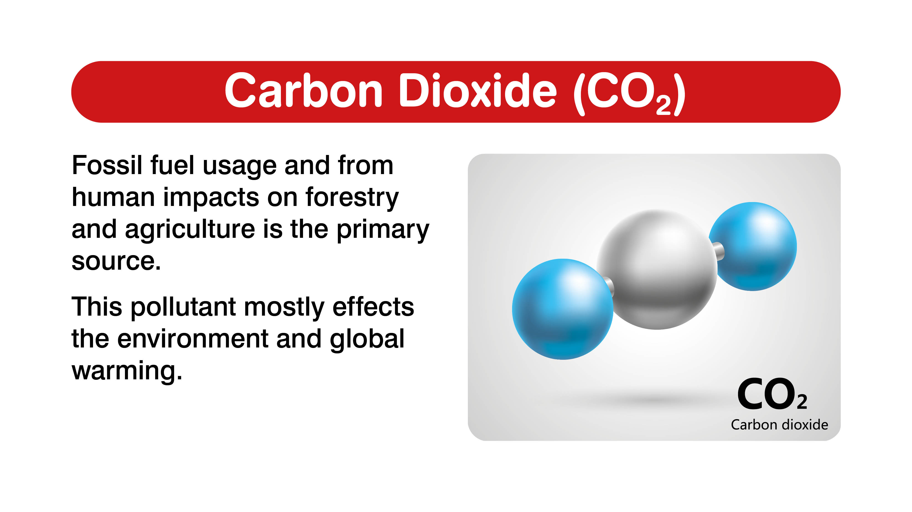

Slide 13
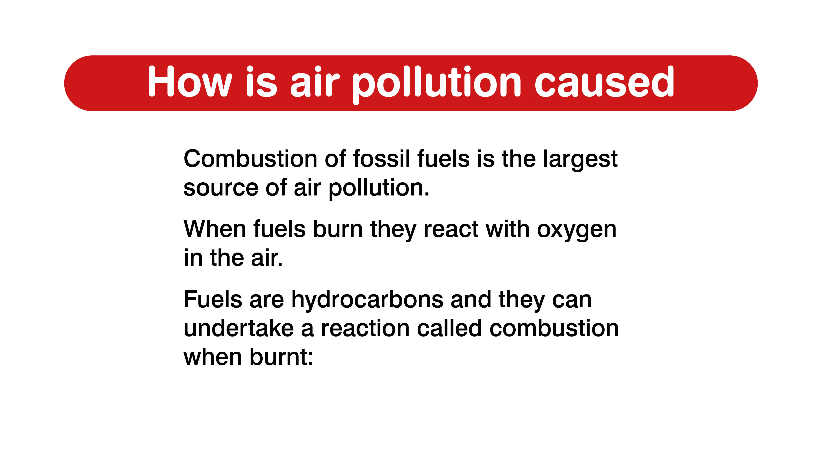

Slide 14
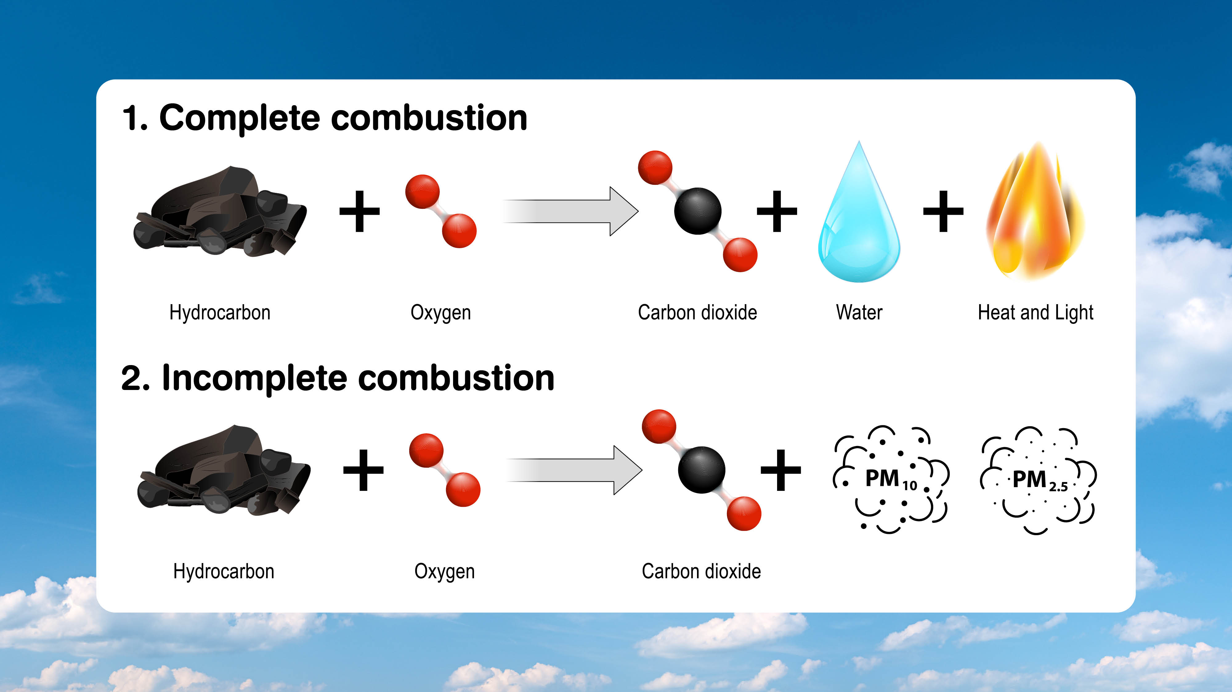

Slide 15
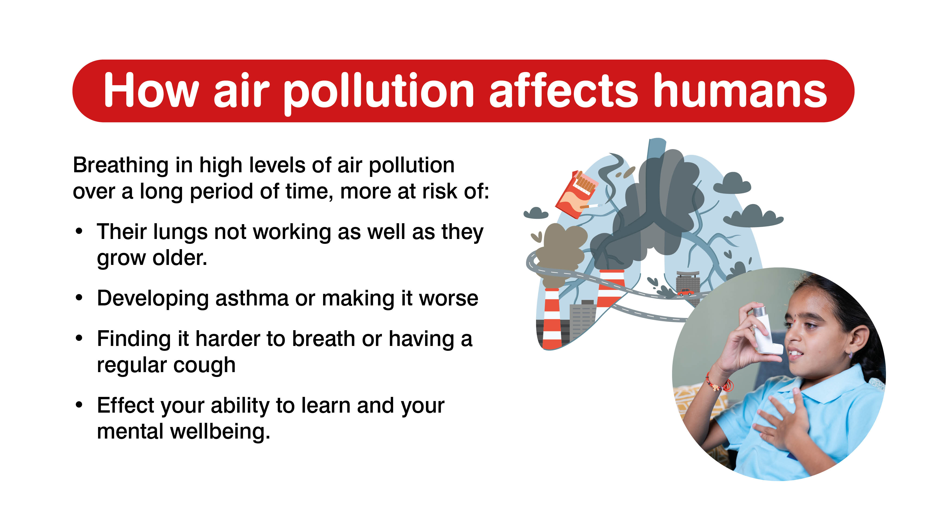

Slide 16
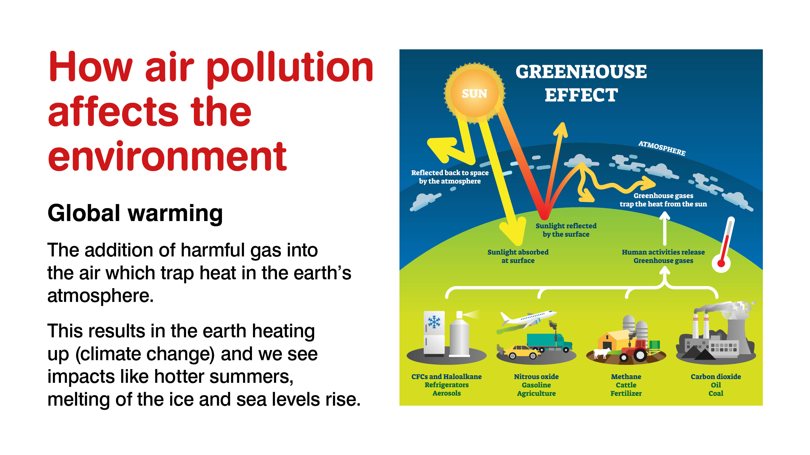

Slide 17
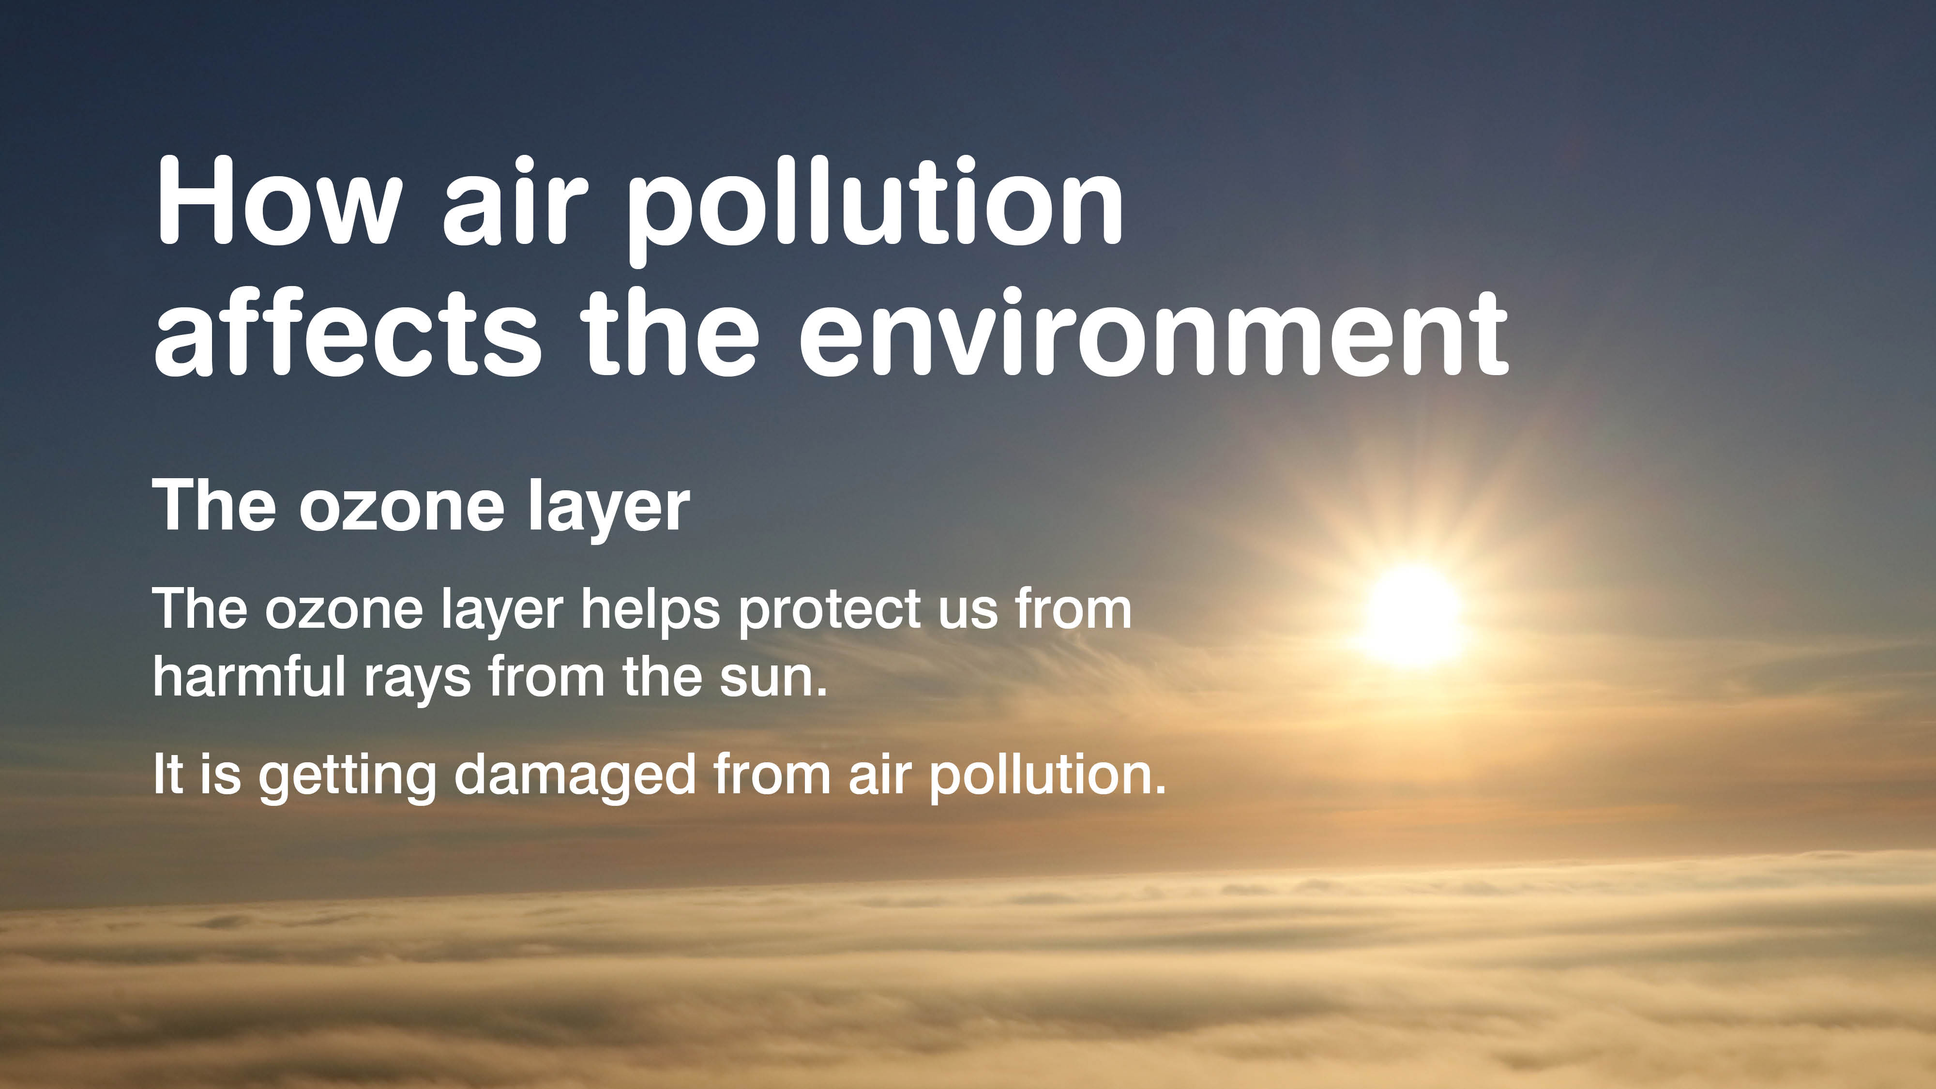

Slide 18
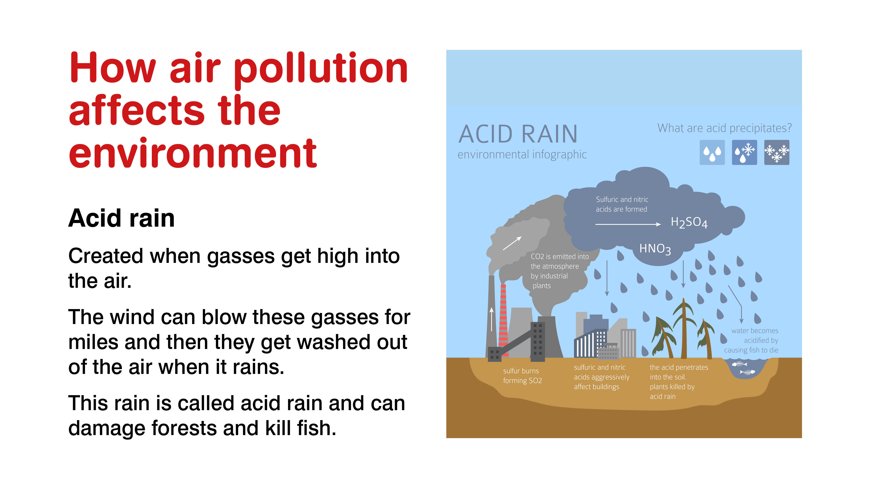

Slide 19
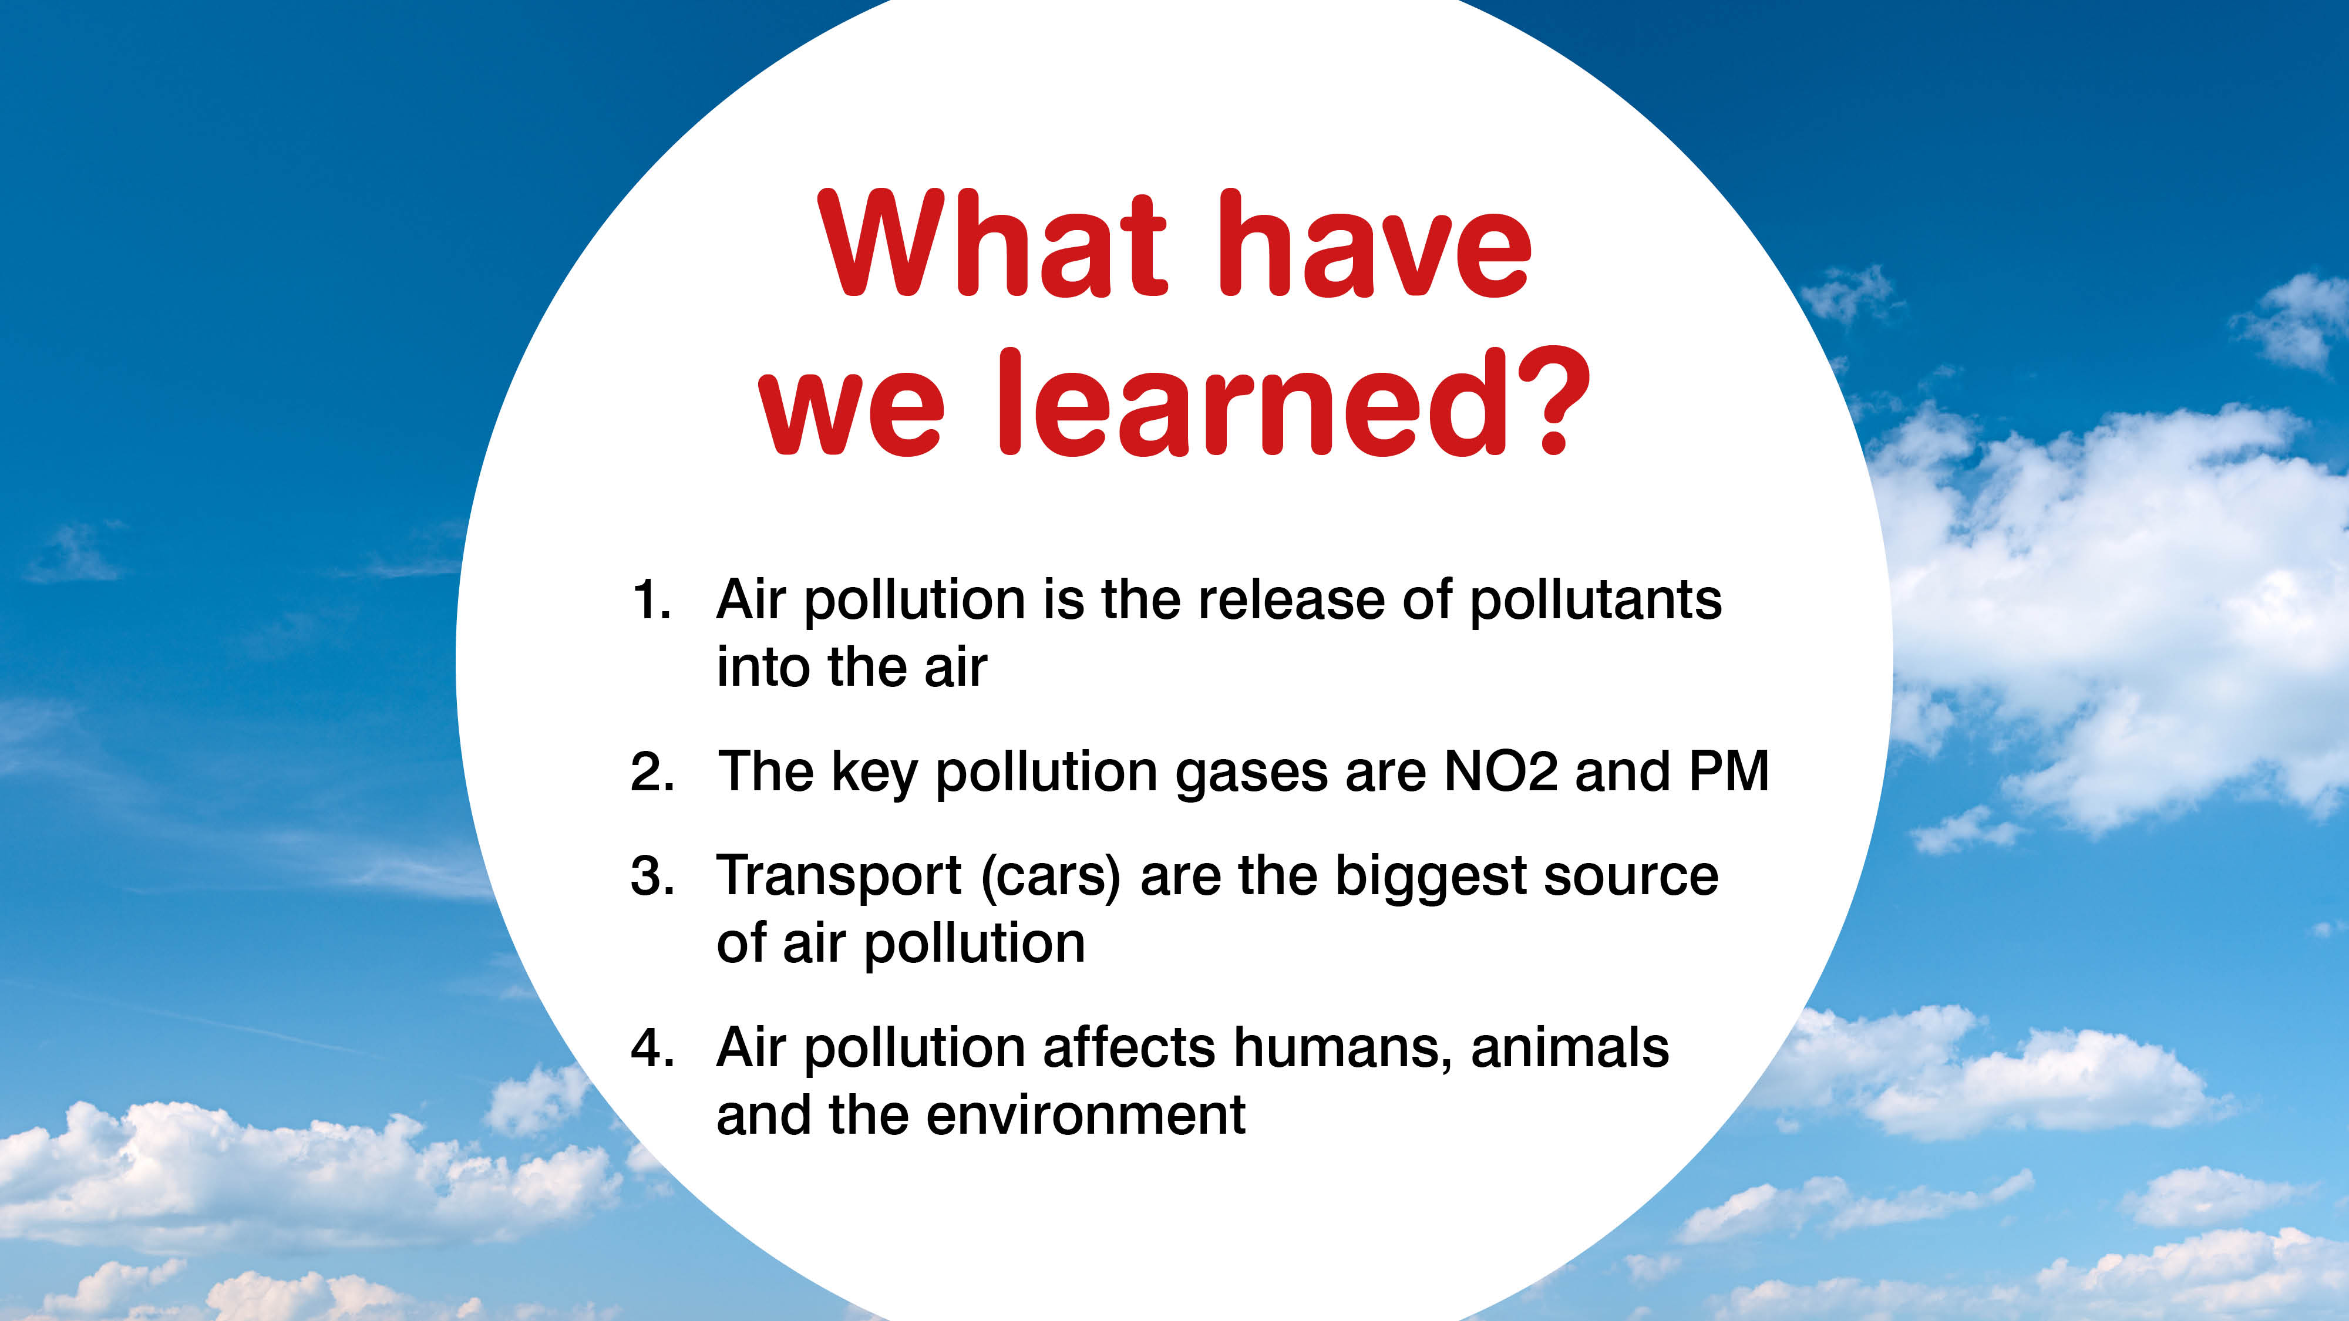

Slide 20
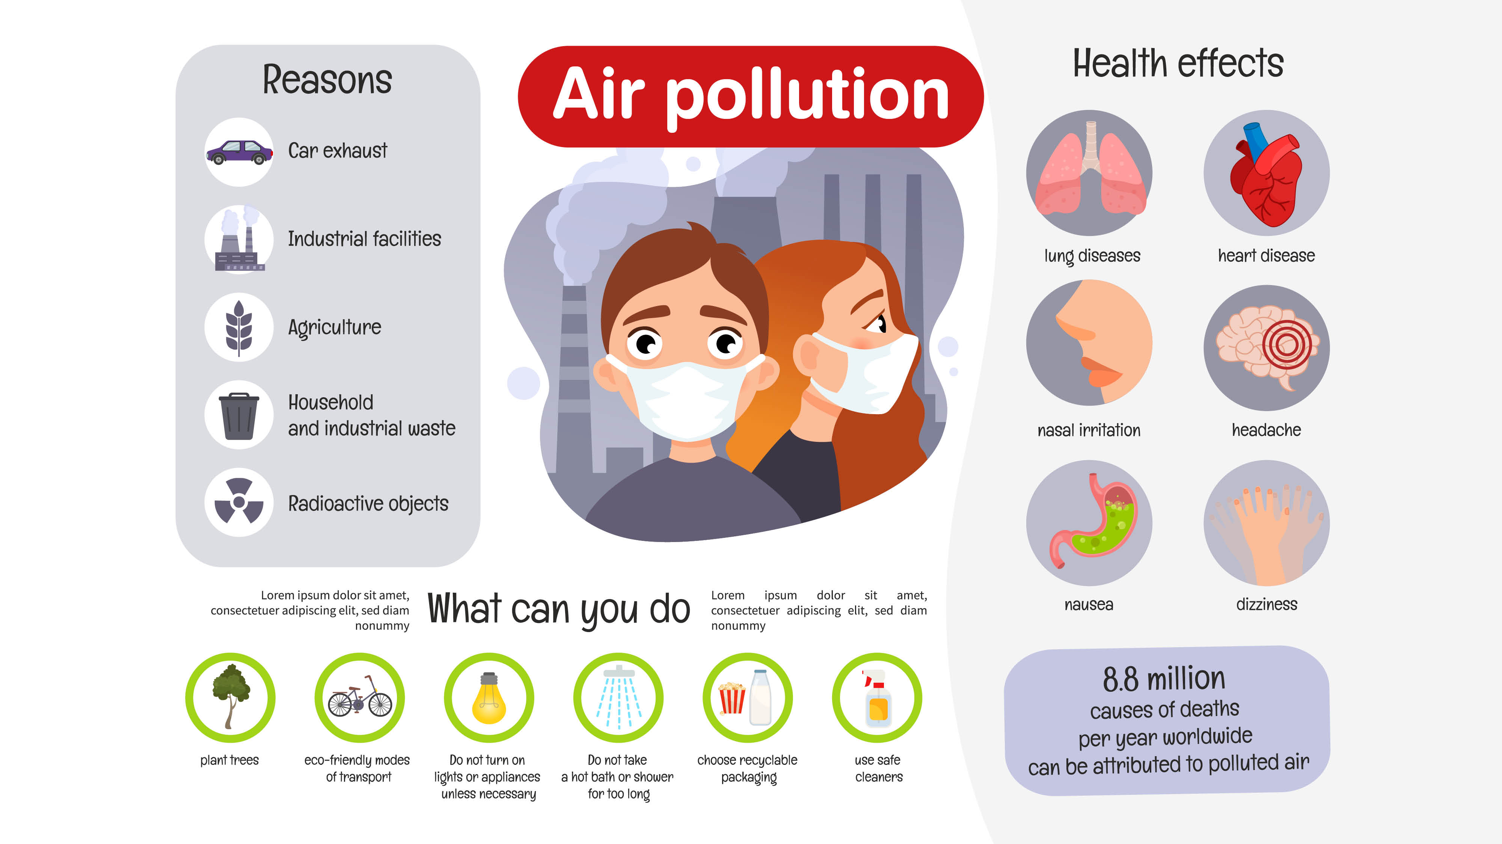

Slide 21


